Slide 1
Lynman Alpha Material YEO Workshop March 11, 2017
by Rich

Slide 2
Cool Hydrogen-containing gas clouds also experiencing expansion.
QSO
Ly-alpha emission

Slide 3
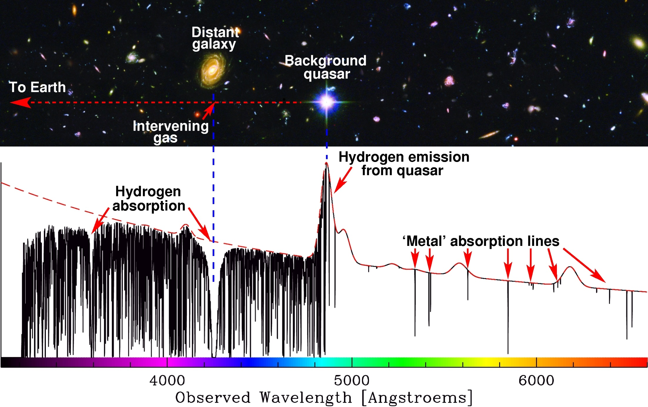

Slide 4
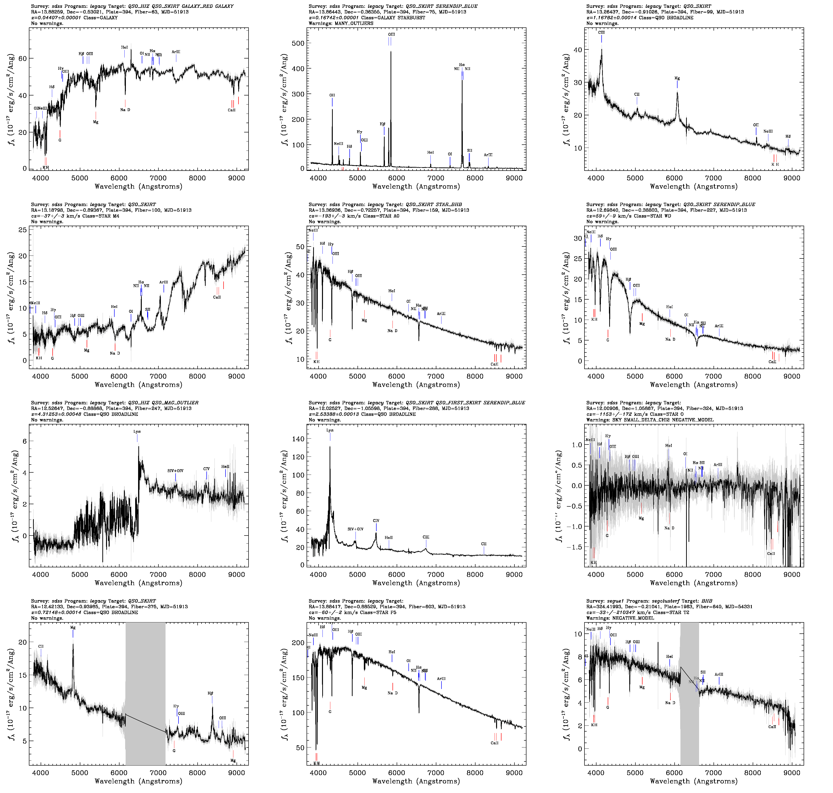
Palette of SDSS spectra:
Lynman-alpha forest in these two spectrra

Slide 5
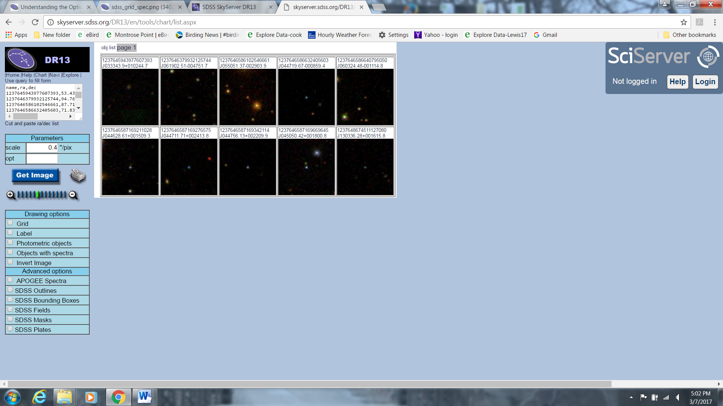
Results of high-red-shift QSO SQL of SDSS DR13:
Subsequent slides show spectra.

Slide 6
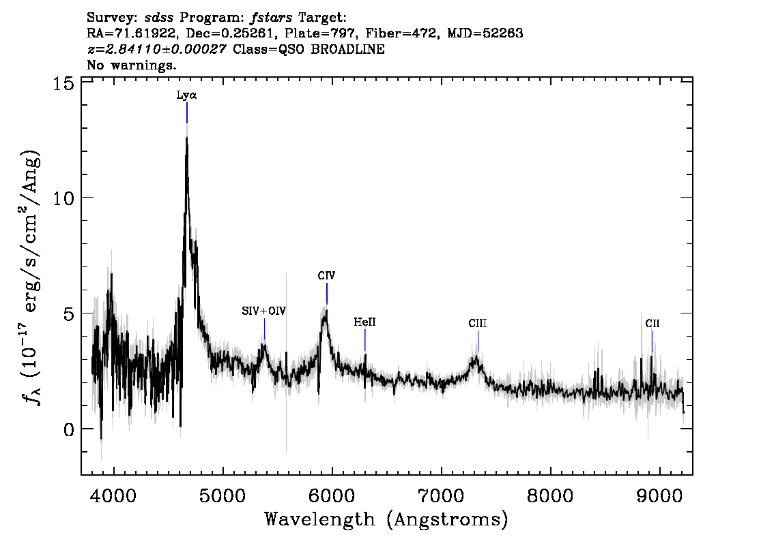
~1216 A in rest frame, highly red-shifted
“forest”

Slide 7
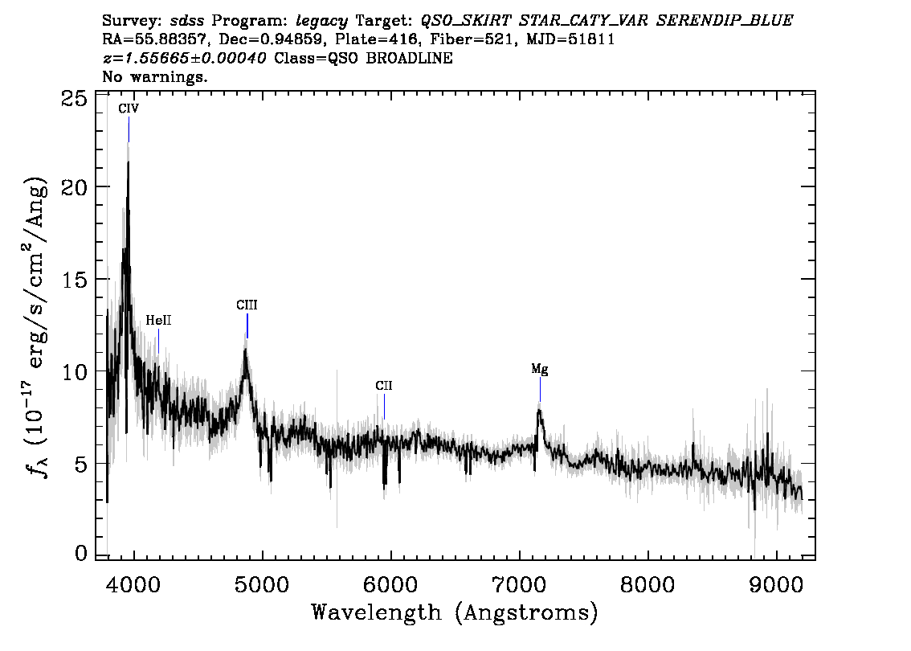

Slide 8
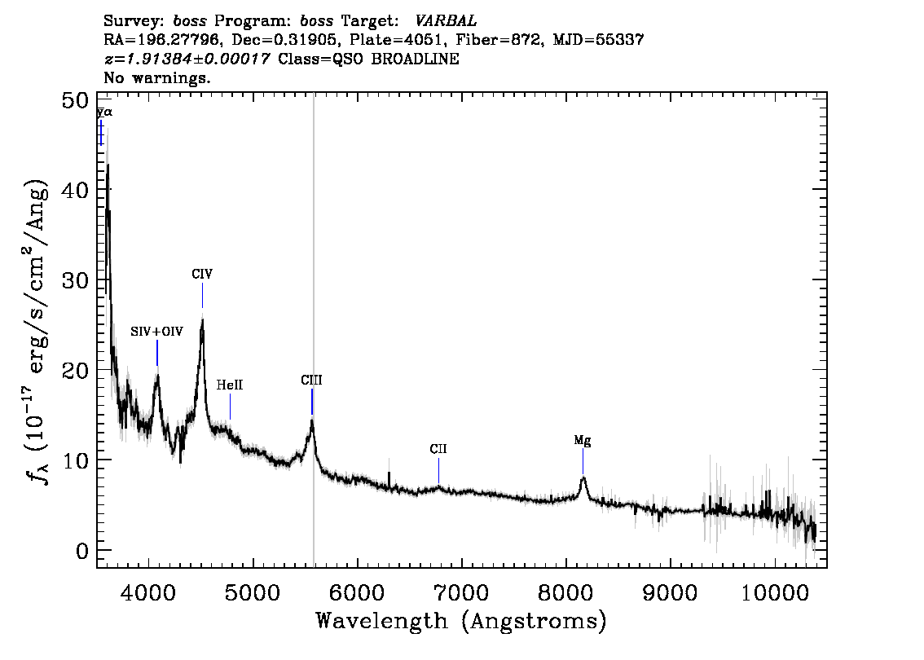

Slide 9
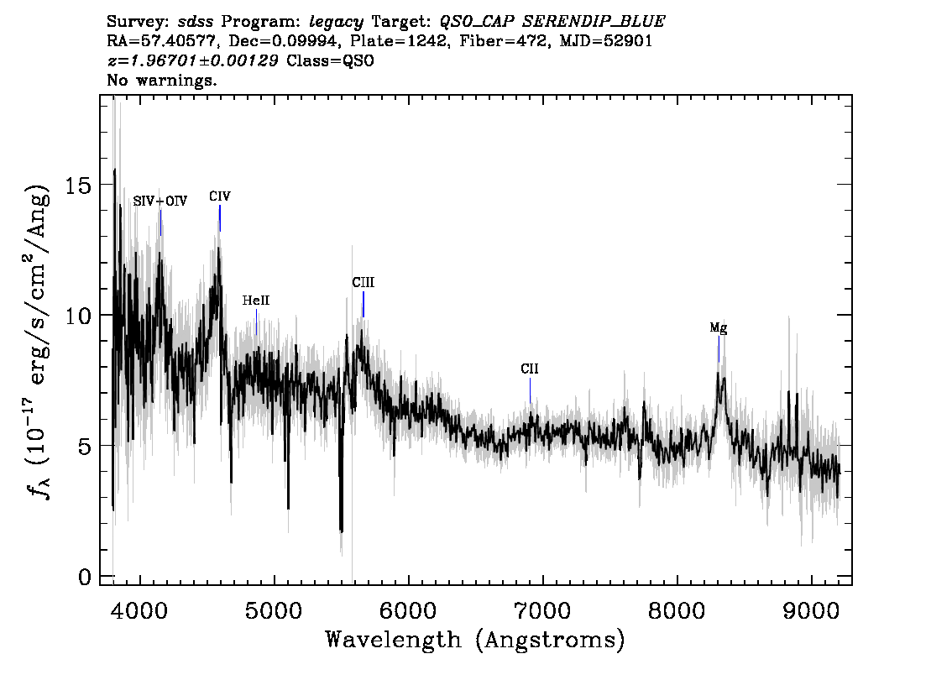

Slide 10
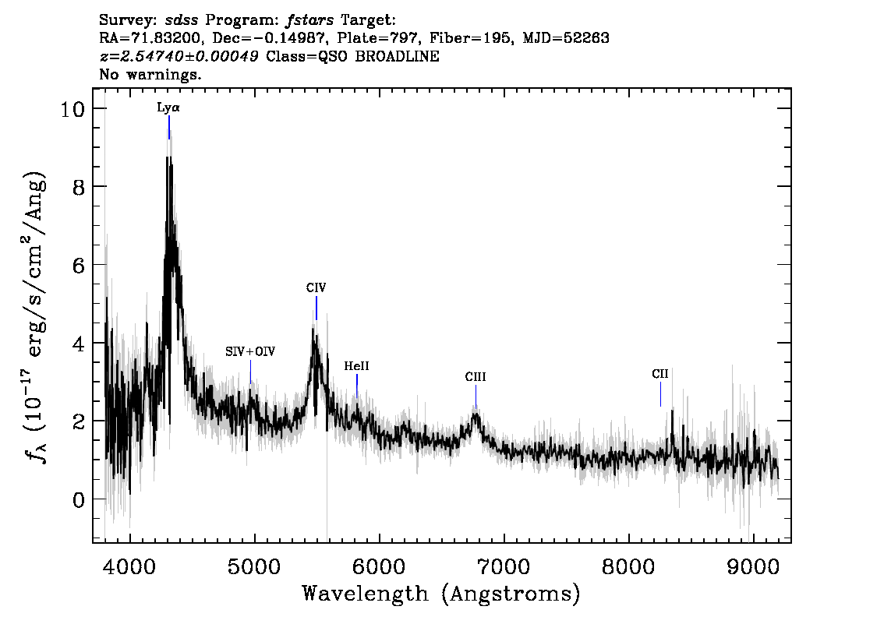

Slide 11
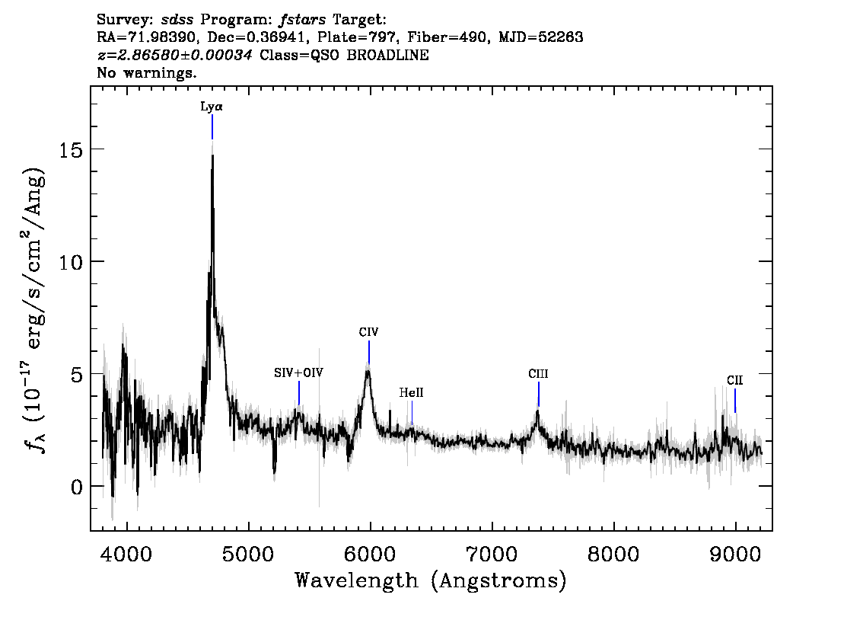

Slide 12
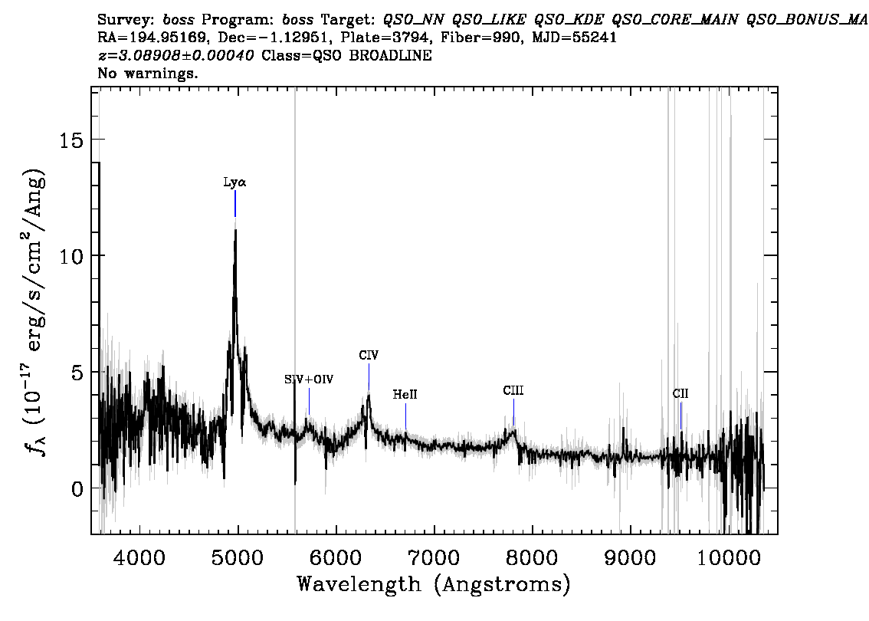

Slide 13
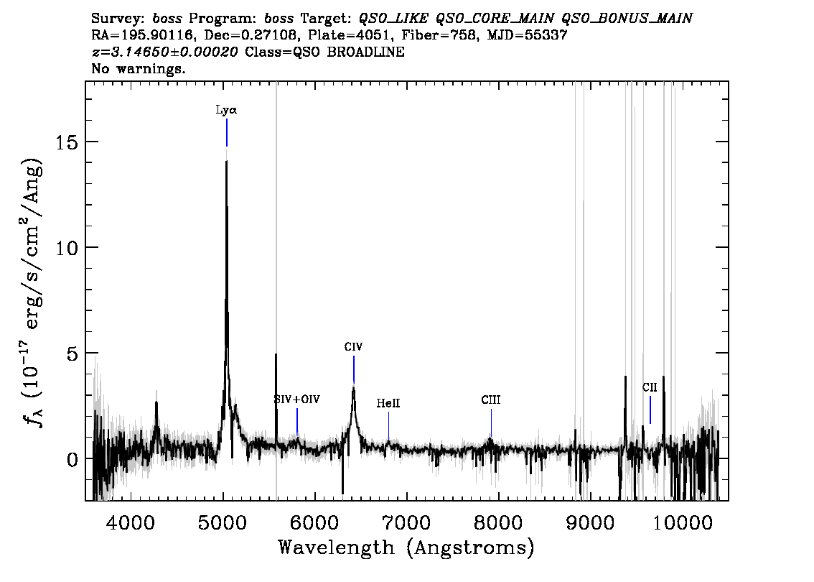

Slide 14
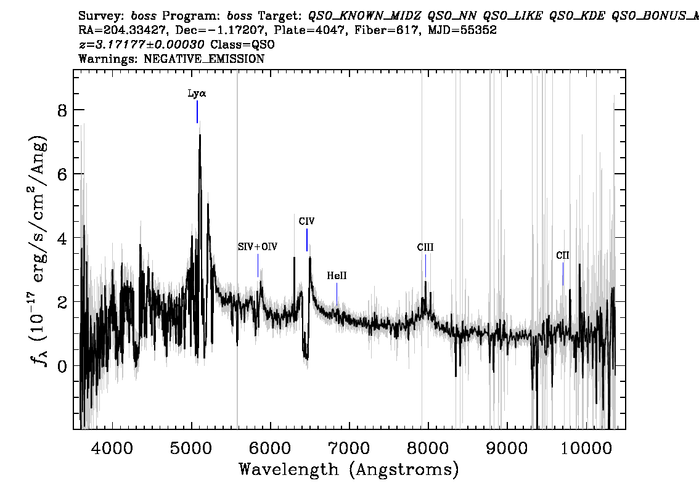

Slide 15
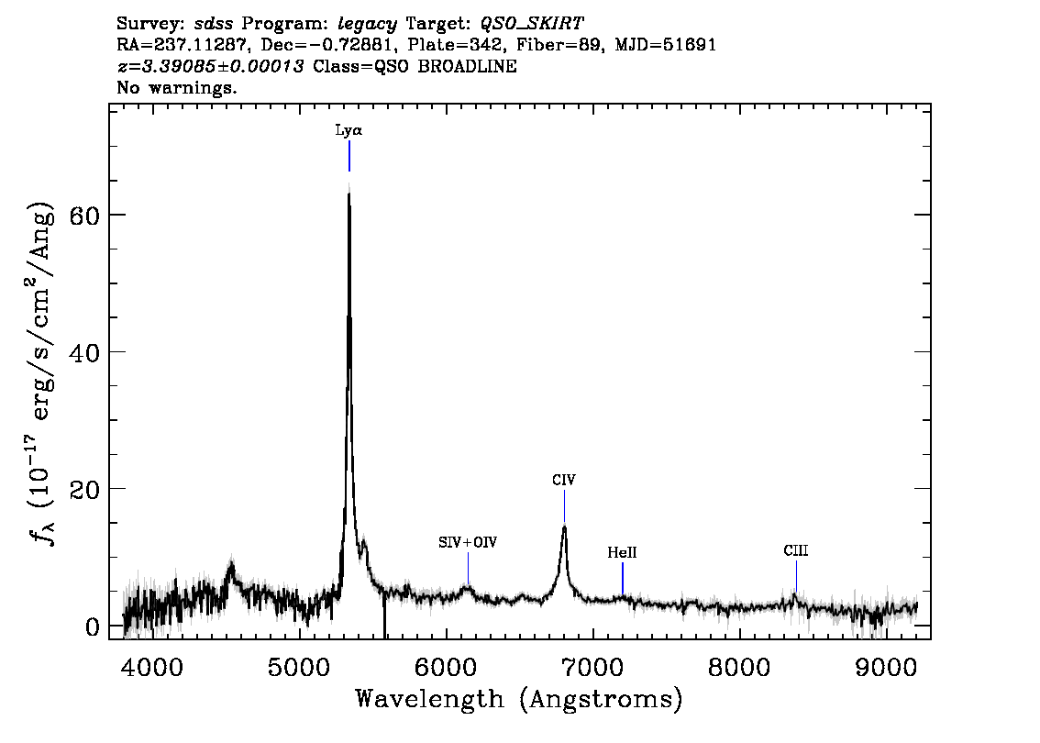

Slide 16
