Slide 1
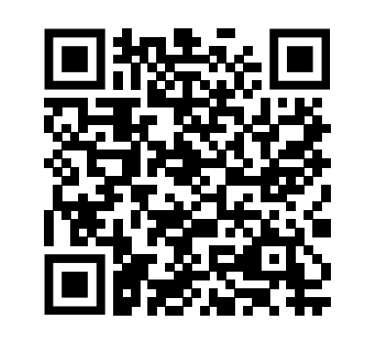
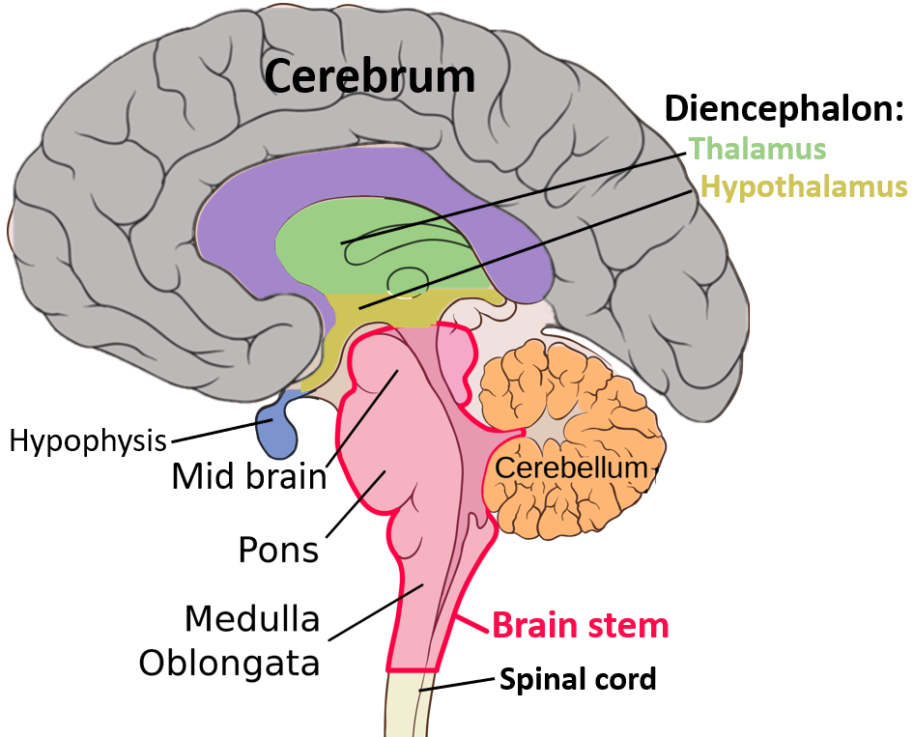
Name___________________________
https://www.memorylosstest.com/brain-processing-speed-test/.
Name___________________________
Directions:
Scan the QR code and take the brain processing speed test. Record your results BEFORE and AFTER spinning.
*Don’t be concerned about the number!
This is just a baseline to investigate changes in cognitive ability.
Take the test and record your score
Spin in a circle for 10-30 seconds
Take the test again and record your score
Did taking the test feel different the second time around? __________________________________________
Why do you think this happened?
________________________________________
Considering this experience, what effect do you think space travel, which puts the body and brain under much more stress than spinning around, could have on cognition?
____________________________________________________________________________
Does your above prediction match with NASA’s results? Why or why not? _____________________________________
Activity
Thinking, communicating, learning, etc…
Cognition
 | Before Spinning * | After Spinning *
Test Score
These experiments focused on Scott’s brain functioning on the ISS and compared them to his brother’s here on Earth.
Results
For the most part, Scott’s cognition remained the same during his long spaceflight. But, worryingly, he experienced a marked decrease in speed and accuracy in the 6 months after his return to Earth.
What are some times when you felt as though your ability to think was worse than normal? How about better?
______________________________________________________________________
____________________________________
4
4
4
1
Notes:
https://commons.wikimedia.org/wiki/File:Basic_structures_of_the_brain_highlighted.png
https://www.memorylosstest.com/brain-processing-speed-test/.

Slide 2
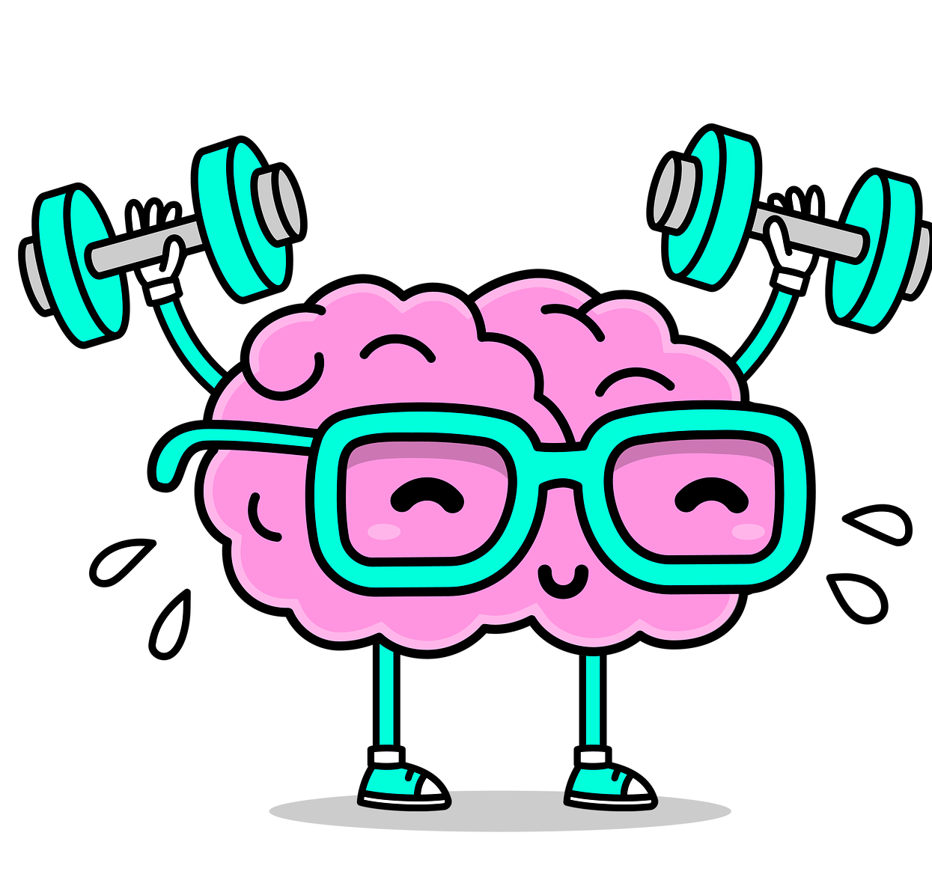
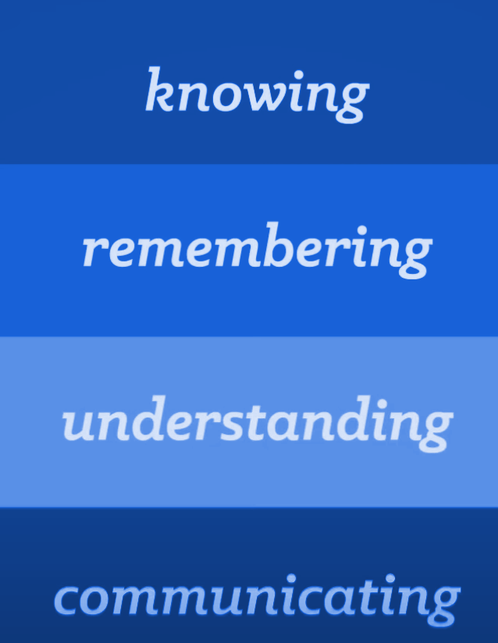
Read
Analyze
The broad term ‘cognition’ includes the many jobs of thinking, like mental alertness, spatial orientation, memory, and recognition and emotions. Cognition generally declines with age.
What do you notice about Scott (TW) and Mark’s (HR) cognitive function in the different evaluationas?
________________________________________________________________________________________
What about after the flight? What, do you think may have been the outcome? ________________________________________________________________________________________
The body has to undergo a lot of physical and mental stress on a space mission. But Scott’s cognition remained the same while in flight. But when Scott returned to Earth his cognition slowed down. He wasn’t able to process information at the same speed during flight. This could be due to many different factors like a busier schedule with more daily activities here on Earth.
Watch
https://www.youtube.com/watch?v=R-sVnmmw6WY
How do teachers measure YOUR cognition? What question would you ask someone to measure their cognition?
________________________________________________________________________
3
2
3
Notes:
https://www.youtube.com/watch?v=R-sVnmmw6WY

