Slide 1
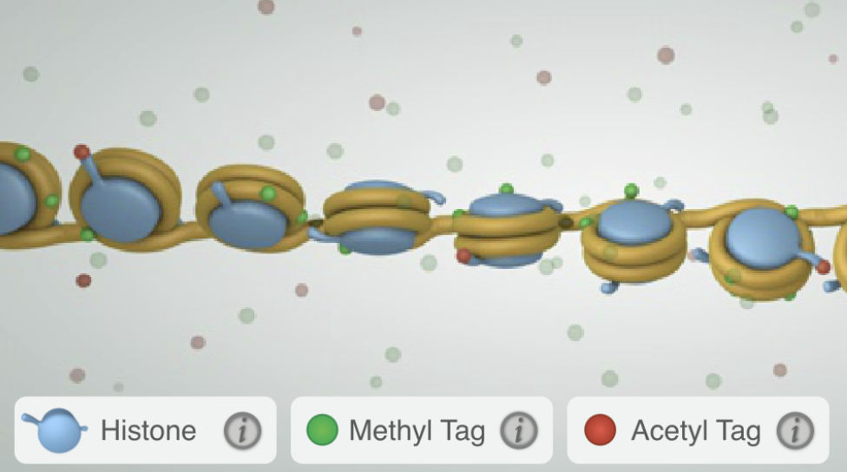
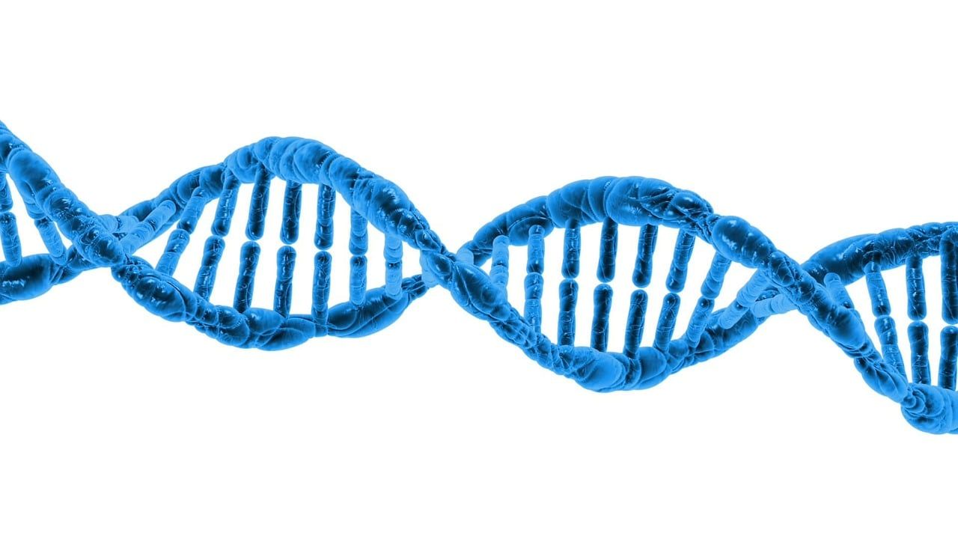
https://learn.genetics.utah.edu/content/epigenetics/control/
Name___________________________
Activity
Name___________________________
Epigenomics
Scientists are trying to better understand the Epigenome to keep our bodies healthy and working right.
The epigenome is a collection of tiny tags or markers that sit on top of your DNA.
Tag
Gene turned on
Directions: Explore the University of Utah’s interactive epigenetics page and track green fluorescent protein (GFP) expression! Then answer the questions below.
Tag
What is a histone?
_______________________________________
What does a methyl tag do to a gene?
_______________________________________
What does an acetyl tag do to a gene?
_______________________________________
Can these tags cause changes in a person’s DNA? Can they change a person’s traits?
_______________________________________
The epigenome helps control how your body works by deciding which instructions (genes) should be used.
Results
Scott’s epigenome was affected by spaceflight. BUT Mark (here on Earth) also experienced changes to his epigenome. So, scientists concluded the changes to Scott’s epigenome was the result of a natural process and not due to the changes in gravity.
Scientists know that some lifestyle choices can cause harmful changes to the epigenome. Name 1 lifestyle choice that could be harmful to the epigenome.
_________________________________________________
4
4
4
1
Notes:
https://commons.wikimedia.org/wiki/File:NHGRI_Fact_Sheet-_Epigenomics_%2826453306774%29.jpg

Slide 2
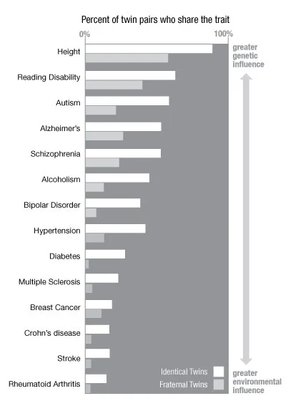
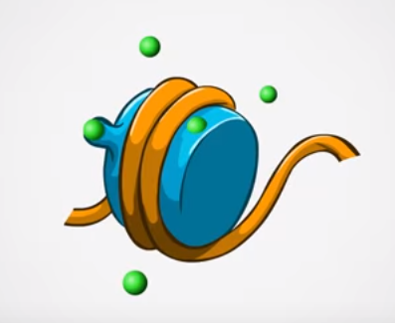
Read
Analyze
Kind of like a light switch, genes can be turned on and off, saving traits for when you need them. The process by which genes are turned ‘on’ is called methylation and the gene is tagged.If a gene is turned ‘off’ it called demethylation. When a methyl tag is found on the Epigenome this means the switch is off, and the gene is turned off which means it is and not producing proteins. But when a methyl tag is off, the switch is on which means the gene is turned on and it is the producing proteins.
Identical Twins
Identical twins = same egg and same sperm
Fraternal twins = different egg and different sperm
“Identical twins are studied because the DNA of identical twins is, as the word indicates, identical. From birth to age three, these twins are very similar in appearance and in their behaviors, but as they grow older, the similarities between the twins begin to differ in appearance, and can even differ in their overall health.”
To the left is an image of a ‘histone’ protein that has DNA wrapped tightly around it. You also see the tags that are ready to ‘unwrap’ the DNA or methylate it so that the gene can be turned on and used.
Watch
https://www.youtube.com/watch?v=_aAhcNjmvhc
The graph shows how similar identical twins are compared to how similar fraternal twins are.
What lifestyle choices can lead to a healthy Epigenome?
_________________________________________________________________________________________________________
If identical twins share the EXACT same DNA, then why don’t we see their traits matching 100% of the time?
____________________________________________________________________________________________________________
2
3
Notes:
https://www.youtube.com/watch?v=_aAhcNjmvhc
https://www.youtube.com/watch?v=MD3Fc0XOjWk
https://learn.genetics.utah.edu/content/epigenetics/twins

