Slide 1
Drake’s Equation
Are We Alone?

Slide 2
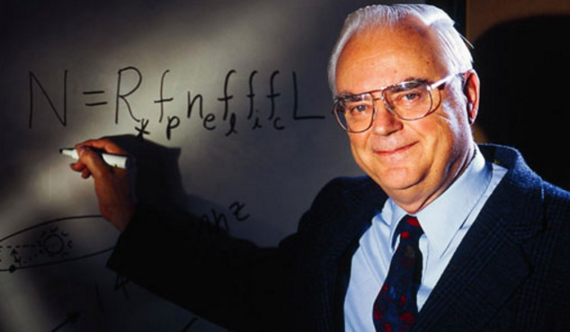
Frank Drake
Notes:
Frank Drake, an astronomer and astrophysicist conducted the first modern search for extraterrestrial intelligence (SETI) experiment in 1960. More than five decades later, the hunt remains front-and-center for this scientist.

Slide 3
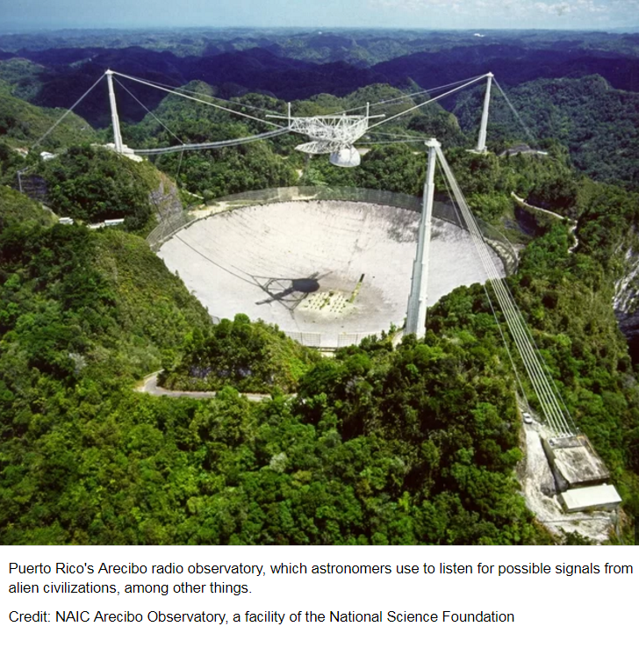
The 1974 message was sent from Arecibo to the globular star cluster M13 and carried basic information about humanity and the Earth.
Notes:
Drake constructed the "Arecibo Message" of 1974 — the first interstellar message transmitted via radio waves from Earth for the benefit of any extraterrestrial civilization that may be listening.
The message was aimed at the current location of M13 some 25,000 light years away because M13 was a large and close collection of stars that was available in the sky at the time and place of a ceremony marking the remodeling of Arecibo.The message was transmitted at a frequency of 2,380 MHz and modulated by shifting the frequency by 10 Hz, with a power of 1,000 kW. The total broadcast was less than three minutes.

Slide 4
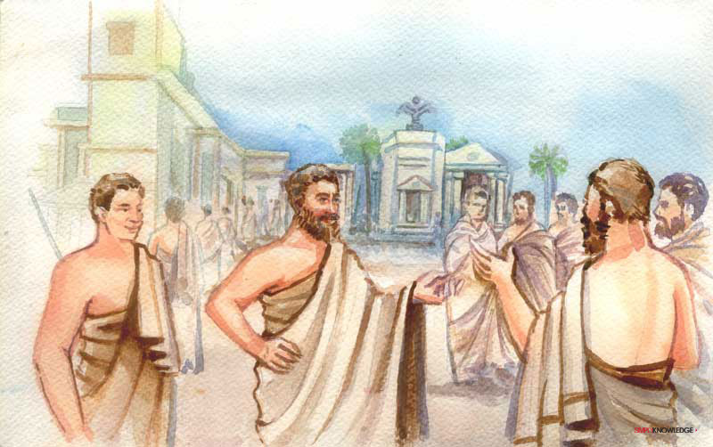
Ancient Greeks debated the possibility of extraterrestrial life.
Notes:
Over two thousand years ago, the ancient Greeks argued over the existence of life on planets, but the idea really took off after the Copernican revolution. Galileo, Kepler and others considered the inhabitability of the planets, while being careful not to upset Church authority.
"The idea blossomed in the 17th century into the 'many worlds view’' debate, but it remained controversial," said Steven Dick, NASA historian.

Slide 5
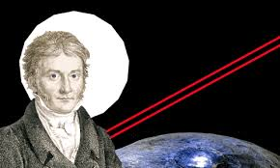
Notes:
Carl Friedrich Gauss, the German mathematician. In the 1820s, he spoke of reflecting sunlight towards the planets with his land surveying invention, the heliotrope. He is also credited with the idea of cutting a giant triangle in the Siberian forest and planting wheat inside.
The thinking ws that the size and color contrast should have made the giant triangle visible from the moon or Mars, and the geometric figure could only be interpreted as an intentional construction.
Twenty years later, the astronomer Joseph von Littrow came up with a similar idea to pour kerosene into a 30-kilometer-wide circular canal that would be lit at night to signal our presence.

Slide 6
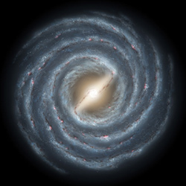
What do you think of the possibility that we are not
alone in our galaxy?
NASA image

Slide 7
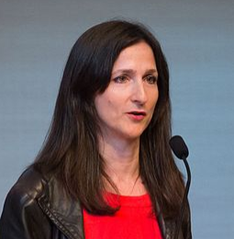
N= R*f_{p}n_{e}f₁f_{i}f_{c}L
Drake -Original Equation (1961)
N = N*F_{Q}F_{HZ}F_{o}F_{L}F_{S}
Sarah Seager Modified Equation
2013
N = the number of civilizations in our galaxy with which communication might be possible
N = the number of planets with detectable signs of life
N*= the number of stars observed
FQ = the fraction of stars that are quiet
FHZ = the fraction of stars with rocky planets in the habitable zone
FO = the fraction of those planets that can be observed
FL = the fraction that have life
FS = the fraction on which life produces a detectable signature gas
R∗ = the average rate of star formation in our galaxy
f_{p} = the fraction of those stars that have planets
n_{e} = the average number of planets that can potentially support life per star that has planets
f_{l} = the fraction of planets that could support life that actually develop life at some point
f_{i} = the fraction of planets with life that actually go on to develop inelligent life (civilizations)
f_{c} = the fraction of civilizations that develop a technology that releases detectable signs of their existence into space
L = the length of time for which such civilizations release detectable signals into space
Notes:
In Drake’s equation, the search was for intelligent life that is radio communicative and found around any stars. Seager (MIT) focused on M-type stars that have a lower luminosity than the sun. These were thought not to be good candidiates but their tidal-lock status with moons is interesting and has proven to work very well to encourage life on Earth. Now scientists know that there would still be good circulation that would maintain global temperatures. Saeger also focuses on any life being present so may be in the form of microbial llife. She is suggesting ‘quiet’ stars that have mellowed down from early violent characteristics, rocky planets (providing the necessary support life needs to, you know, standup and stuff),
Saeger’ equation focuses on the search for planets with biosignature gases, gases produced by life that can accumulate in a planet atmosphere to levels that can be detected with remote space telescopes

Slide 8
https://www.brainpop.com/games/drake
equation/index.weml
Work in a group of several people and determine what variables you might use to determine the number of possible worlds for communication.
Notes:
The Drake Equation Game gives a great opportunity for collaboration and discussion on the possile existence of civilizations of intelligent life that could be in our galaxy. This game is slightly different than the original or modified Drake’s Equation.

Slide 9
http://seti.org/
https://einsteinathome.org/
Notes:
The public can view data being collected by radio telescopes and collectively help search for intelligent life on other planets. SETI Live was created in collaboration with Zooniverseteam at Chicago’s Adler Planetarium and is the latest development “to empower Earthlings everywhere to become active participants in the ultimate search for cosmic company.” Anyone is able to collect and nalyze data for SETI for radio bursts from alien worlds and to look for pulsars through Einstein At Home.

