Slide 1
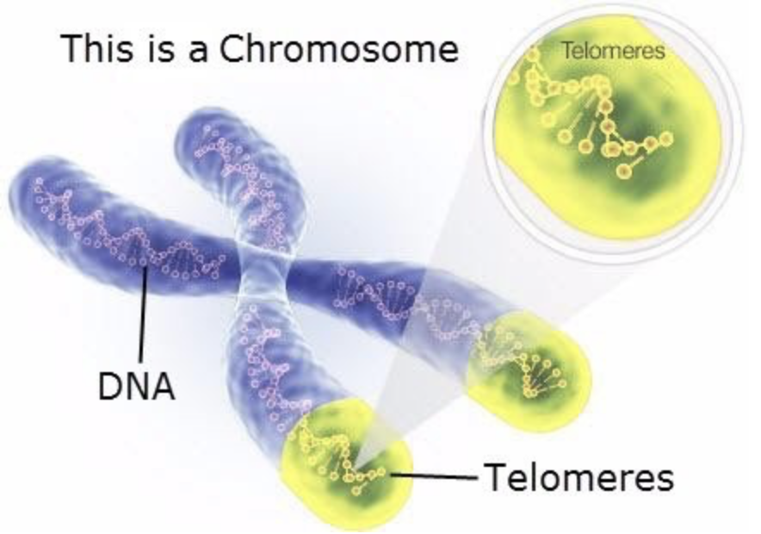
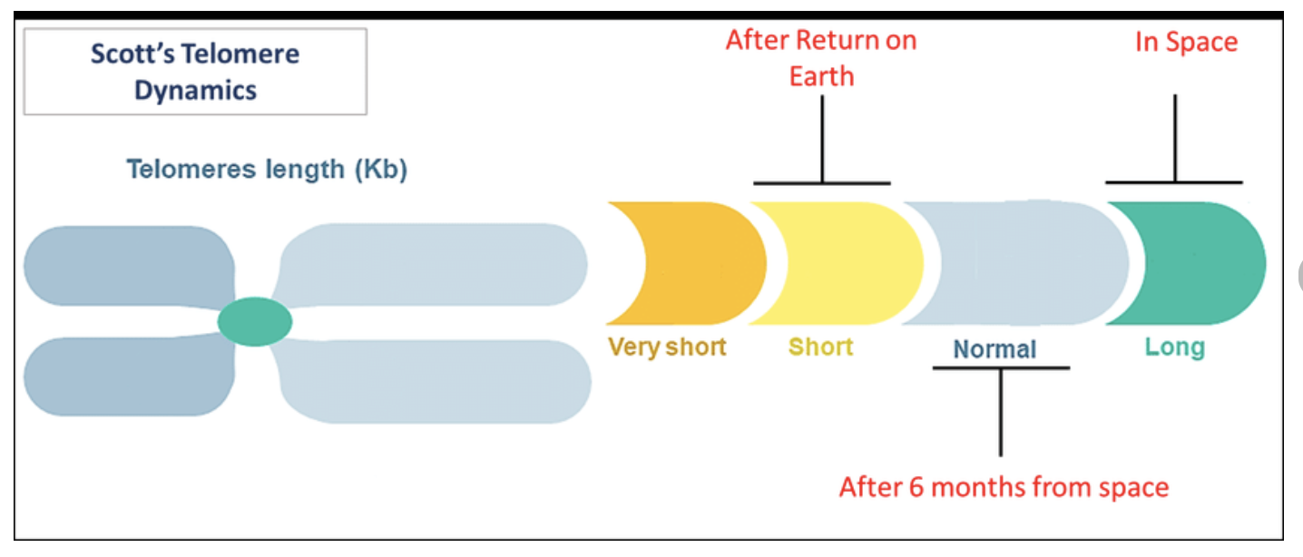
Name___________________________
Name___________________________
Telomere Elongation
Scientists looked closely at Scott’s DNA while aboard the ISS and discovered something interesting.
Telomeres: Telomeres protect our chromosomes, as plastic handles protect jump ropes. Telomere lengths tend to get shorter as we age; however, lifestyle factors, stresses and environmental exposures can also affect the rate at which this shortening occurs. One of the most striking discoveries from NASA’s Twins Study is that Scott experienced a change in telomere length dynamics during spaceflight and within days of landing.
What are some potential consequences of cells with critically short telomeres? ___________________________________________________________________________________________What lifestyle choices do you think can lead to:
Results
Longer Telomeres
Shorter Telomeres
Directions: Look at the diagram above then answer the questions below.
What happened to the length of Scott’s telomeres during his year in space? ______________________________________What happened to them when he returned to Earth?
______________________________________
4
4
4
1

Slide 2
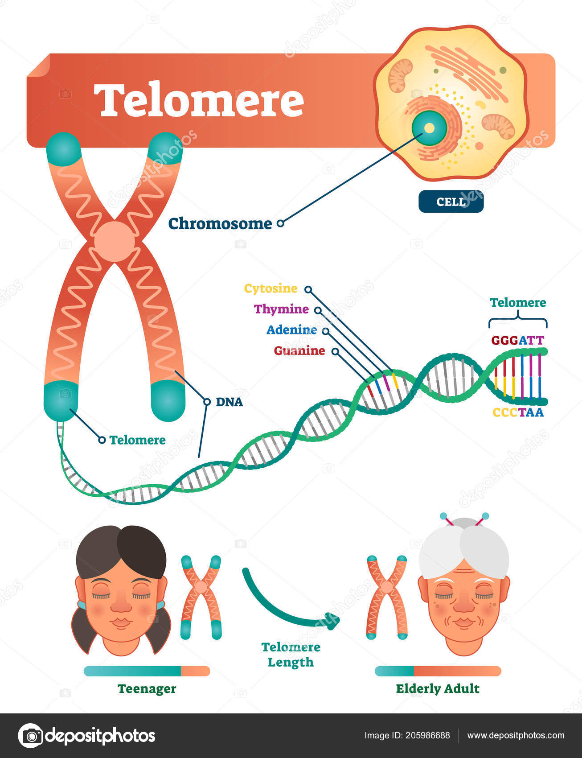
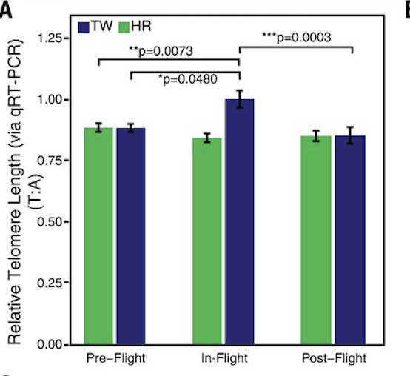
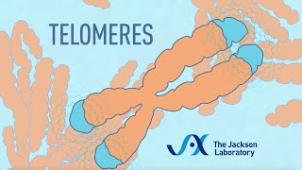
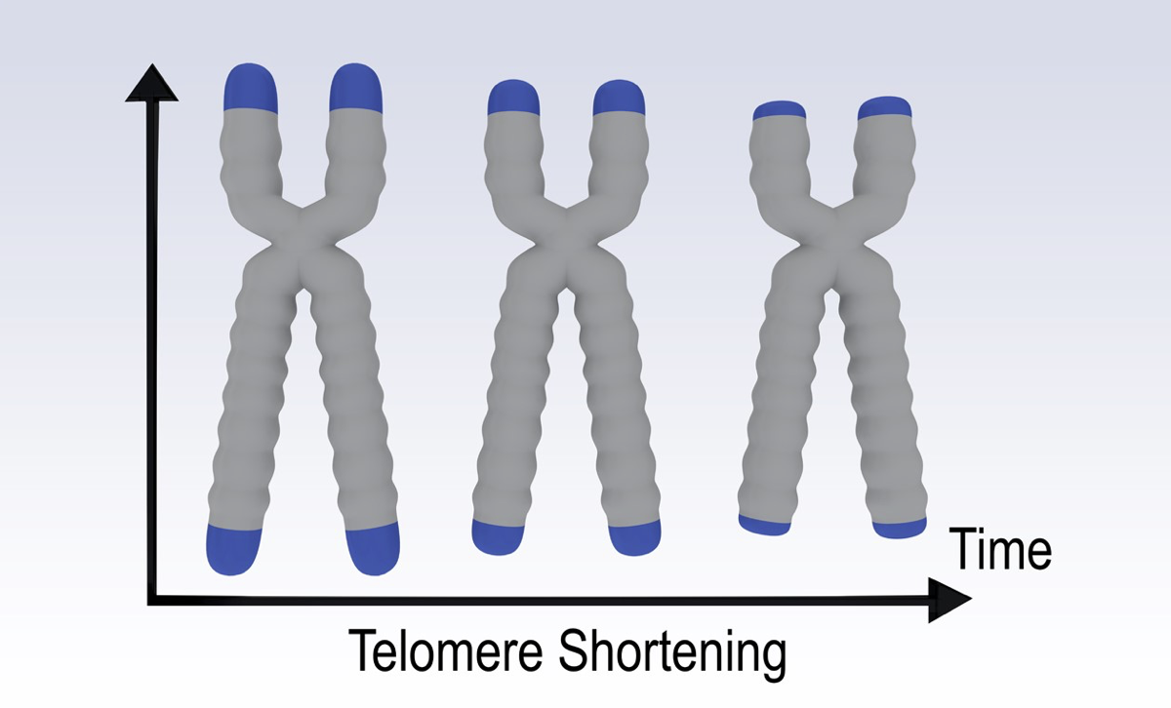
Read
The end parts of the chromosomes (see the tips of the chromosomes in the picture on the left) are called telomeres. Their name derives from Greek telos- that means ‘end’ and -meros that means ‘part’, and they are literally ‘the end part’ of chromosomes. Telomere ends serve to protect the DNA. They are often compared to the plastic protective tips in shoelaces that protect a shoelace from unravelling. At the same way telomeres play an important role in protecting the DNA and keeping it stable.
Analyze
What do you see happening with Scott’s telomeres (TW)?
________________________________________________________
What is happening to Mark’s telomeres (HR)?
______________________________________
Watch
What are telomeres, and what is their job?
___________________________________________________________________________________________________
Aging and age-related diseases, like cardiovascular disease and cancer, are associated with shortening of telomeres. By comparing changes in telomeres and telomerase in twin astronauts, unrelated crew members, and ground controls, this investigation seeks to identify spaceflight specific and individual factors that may make people more (or less) susceptible to accelerated shortening of telomeres. Results may improve efforts to mitigate the effects of aging and disease in people on Earth.
In the span of a lifetime, when are your telomeres the longest?
______________________________________________________
How are telomeres similar to the tips on shoelaces?
__________________________________________________________________
3
2
3

