Slide 1
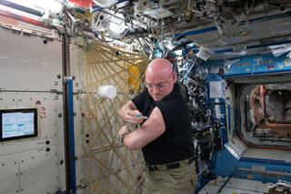
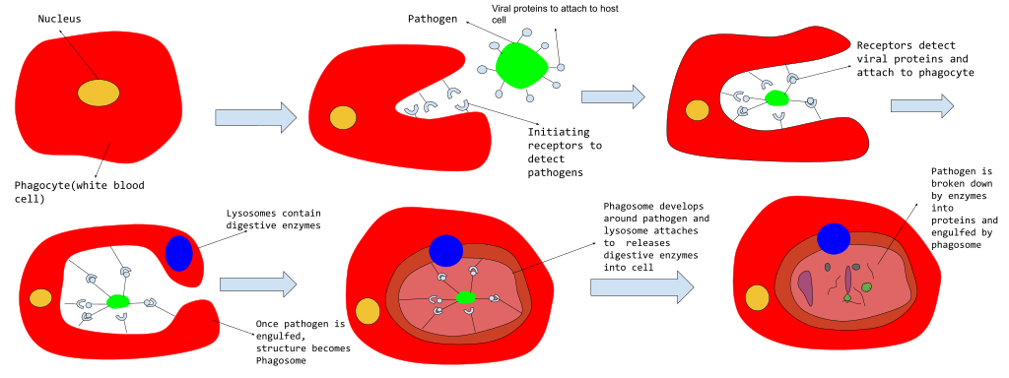
Name___________________________
Phagocytosis
Name__________________________
Directions: Work in groups of 4 and draw 1 step in the phagocytosis process. When your group is finished put the steps in order.
Immunome
A set of genes, proteins and cells that are part of the human immune system
The experimentfocused on the response a human body has to a vaccine in space.
Astronaut Scott Kelly giving himself a flu vaccine on the ISS (International Space Station)
Results
Which stage of immune defense is your cartoon depicting? (circle one):
1.Recognition 2.Signaling 3.Engulfing 4.Digesting
Scott and Mark both received the flu vaccine at the same time. NASA scientists discovered that the twins had a normal immune response. This means, Scott’s body on the ISS reacted appropriately to the vaccine! This is promising for future space expeditions because it means that vaccines can work in space.
How did NASA scientists find out that Scott's immune response to the flu vaccine was normal, and why is this discovery important for future space expeditions?
__________________________________________________________________________________________
4
4
4
1
Notes:
https://commons.wikimedia.org/wiki/File:Process_of_Phagocytosis.svg

Slide 2
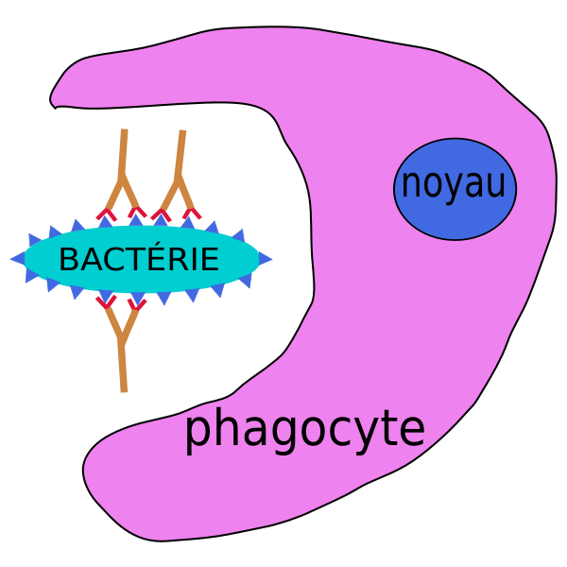
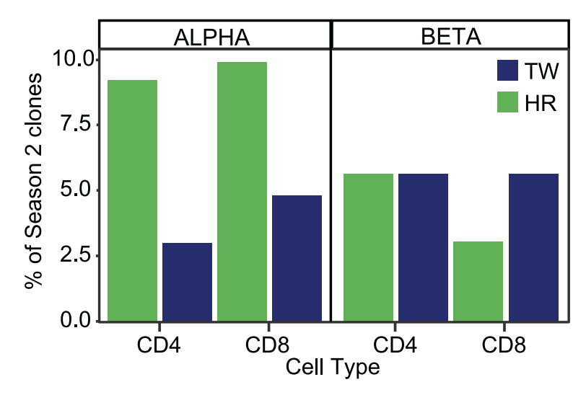
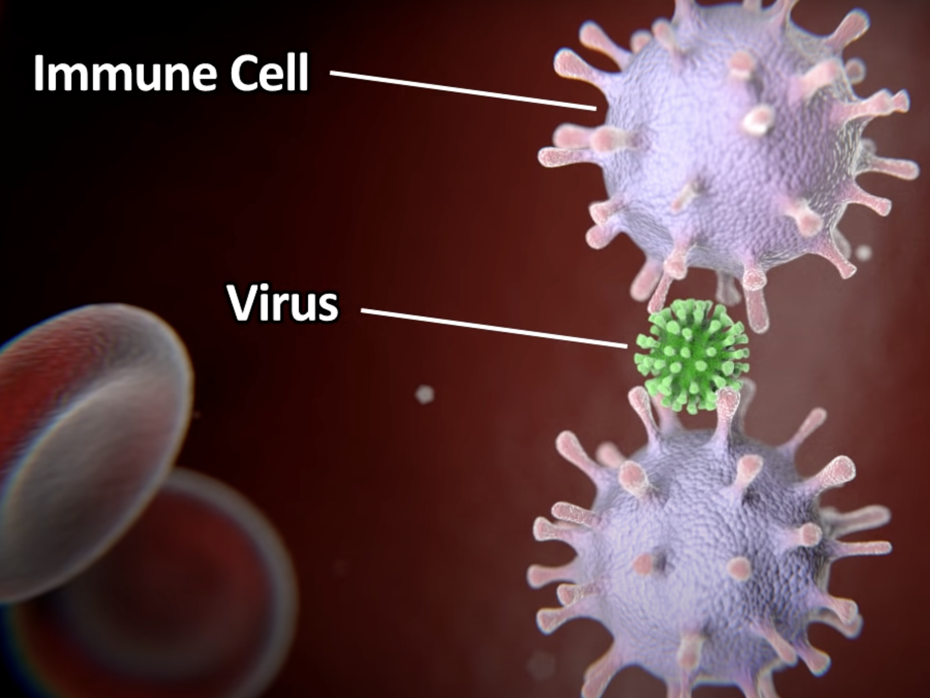
Read
Analyze
The immune system is our body’s defense against viruses, bacteria, and other foreign invaders that we call antigens. Vaccines are given to protect us against these invaders. The vaccine is a weakened form of the antigen (invader) and causes the body to produce cells that recognize
The bars on the graph represent the relative amount of immune cells.
and kill the antigens. When a vaccine is given, our body produces some very cool cells. A Phagocyte surrounds the invader and kills them! The immune system also produces many other cells and proteins that identify foreign invaders, live a long time in humans and protect us for many years.
 | CD4 | CD8 | T-Cell
What is it? | a protein on T-cells | a protein on T-cells | white blood cells
What does it do? | helps the cells communicate | helps T-cells signal | fights infection
Watch
https://www.youtube.com/watch?v=z43cNmfKUsc
Which type of cells were expressed significantly more in Mark (HR)?
___________________________________________
What is their purpose?
___________________________________________
What differences do you notice between Mark (HR and Scott’s (TW) alpha and beta cell expression?
__________________________________________________________________
What are the 4 reasons the video gives to explain why microgravity causes immune system problems..
4
3
2
4
3
Notes:
nasa twin study immunome
https://freesvg.org/1338639792
https://www.youtube.com/watch?v=z43cNmfKUsc

