Slide 1
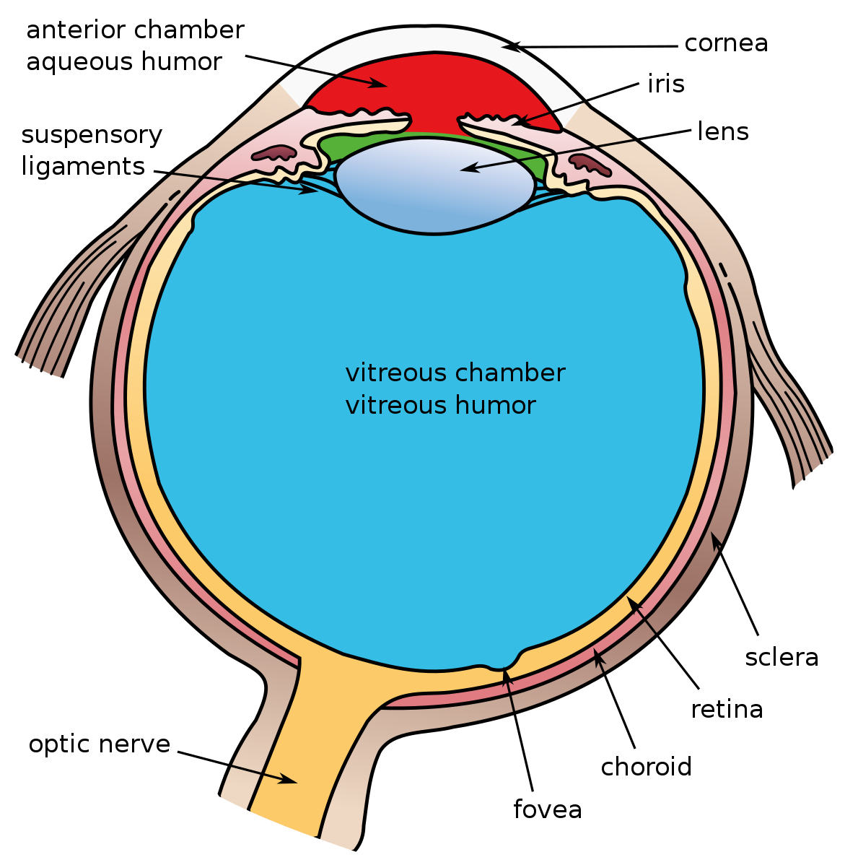
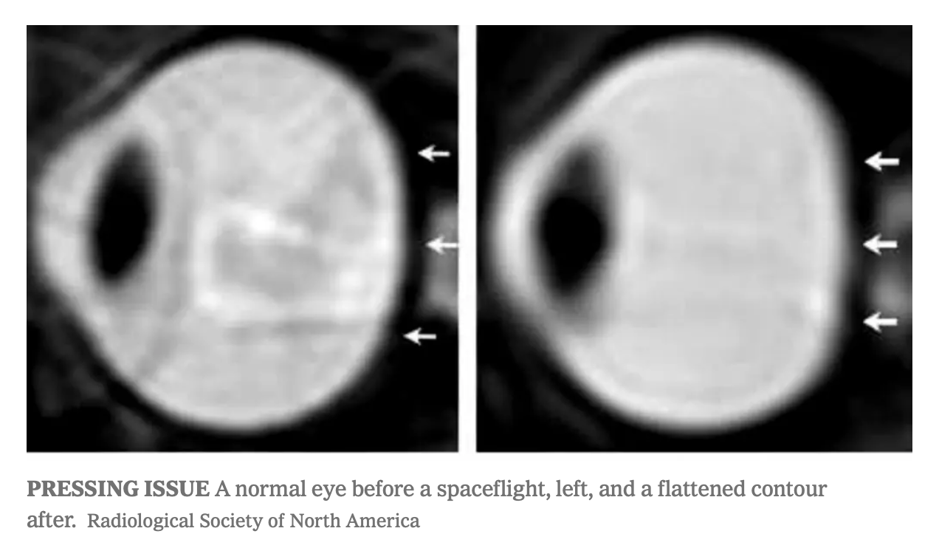
Name___________________________
Activity
Directions: Research the anatomy of the eye, then fill in the blanks below.
Name___________________________
Proteomics
Proteomics is the study of proteins in the body and how microgravity effects them.
Proteomics: The proteomics team studied fluid shifts in the body, the structure of the eye, and proteins in urine to see if changes in protein pathways in response to fluid shifts might contribute to some astronauts’ vision problems.
Directions: In the space below DRAW a picture of an astronauts eyeball that has SANS. Remember the SHAPE of the eyeball changes (flattens) and there is swelling around the optic nerve. Then label those changes.
Results
They found classic symptoms of what is now known as Space-Associated Neuro-Ocular Syndrome (SANS). Symptoms include swelling in the optic disc, which is where the optic nerve enters the retina, and flattening of the eye shape. When researchers looked back, they found certain aspects of SANS in even the earliest spaceflights.
How Microgravity changes the shape of the eyeball:
Microgravity causes changes to the shape of the eyeball. How do you think this interferes with an astronauts ability to do their job?
__________________________________________________________________________
4
4
4
1
Notes:
https://commons.wikimedia.org/wiki/File:Three_Internal_chambers_of_the_Eye.svg
https://www.science.org/doi/10.1126/science.aau8650#
https://www.newscientist.com/article/dn21585-space-is-bad-for-astronauts-eyes/

Slide 2
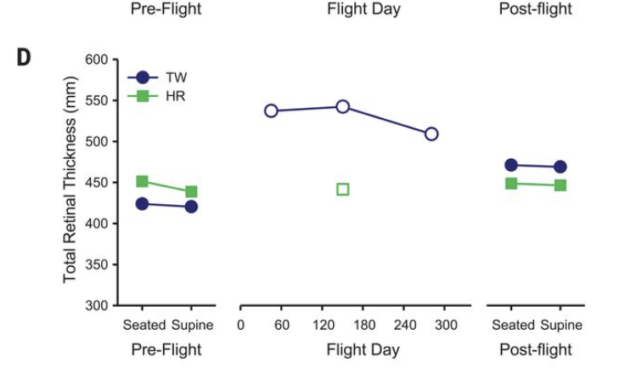
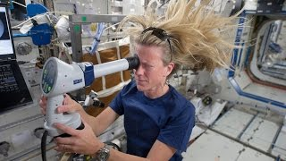
Read
Analyze
NASA’s Human Research Program (HRP) launched another experiment, Ocular Health, which gathered data from station crew members during and after flight from March 2013 to September 2016. Another investigation, Fluid Shifts, began in 2015 and continued through fall 2020. It measures fluid movement into and out of the head to determine how these shifts may lead to changes in the eye. The study was the first to reveal changes in how blood drains from the brain during weightlessness. In addition, the study evaluated the use of a device that creates a pressure difference on the lower body to prevent or reverse fluid shifts. NASA’s one-year mission also included vision among the physical changes it examined.
Below are the results of Scott (TW) and Mark’s (HR) Retinal thickness. Scientists look at this measurement to better understand how fluids in the body shift or change locations.
What other changes (besides vision) might the astronauts have as a results of this fluid shift that occurs in space?
_______________________________________
_______________________________________
What do you see happening to the Twins’ Retinal thickness?
Watch
https://www.youtube.com/watch?v=xtq3b_HYg9w&t=2s
Timing | Retinal Thickness in millimeters
 | Scott (TW) | Mark (HR)
Pre-Flight
Flight Day
Post-Flight
Vision changes on the ISS are common, what do the astronauts do to counteract this problem?
________________________________________________________________________
How do you think Scott’s vision was affected by his time at the ISS?
________________________________________________________________________
_____________________________________
2
3
3
Notes:
https://www.youtube.com/watch?v=xtq3b_HYg9w&t=2s

