Slide 1
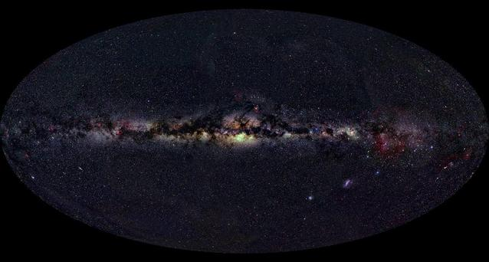
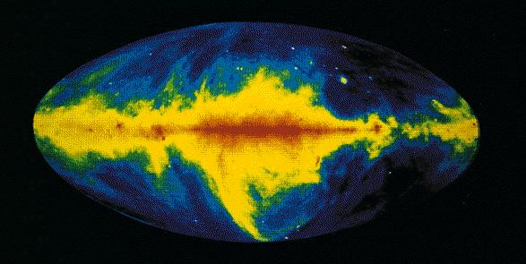
The Milky Way in “radio”
Notes:
By 1934, Jansky wrote to his father and said: “Have I told you that I now have what I think is definite proof that the waves come from the Milky Way? However, I’m not working on the interstellar waves anymore.”
His boss had set him to work on matters of more immediate concern, matters which:
. . Not near as interesting as interstellar waves, nor will it bring as much publicity. I’m going to do a little theoretical research of my own at home on the interstellar waves, however.”
He did not build his own antenna, but still wondered and wrote a few reports.
Some things were in his favor:
Jansky’s antenna was blind to the sun’s radiation during the day at his chosen frequencies. The mid 1930’s were a time of sunspot minimu, which meant 20 MHz waves could get through at night. Had Jansky been observing at suspot maximum, the ionosphere, whose reflecting properties vary with time of day and season as well as sunspot cycle, would have blocked out all 20 MHz radio waves from space, and he would not have discovered the signals from the Miilky Way. As observed from the surface of the earth, the Milky Way’ happens to reach its max brightness in the radio band close to Jansky’s chosen frequency.
He failed to pursue his discoveries any further because there were other projects to be done, “star noise could come later” he was told by his employers. It was to be years before significant follow-up work began. A few astronomers in the US and Europe had become aware of Jansky’s work, but any plans to look more closely at his discoveries had to be shelved when World War II broke out. In any event, most astronomers knew absolutely nothing about radio receivers and antennas, so how could they get involed? Optical astronomers were just not equipped with the skills necessary to tinker with radio sets. After the war, it was mostly radio physicists who launched the new science, and they had to learn astronomy in the process.
Jansky wrote to the famous physicsist, Sir Edward Appleton:
“If there is any credit due to me, it is probably for a stubbonr curiosity that demanded an explanation for the unknown interference and led me to the long series of recording necessary for the determination of the actual direction of arrival.”
Such stubborn curiosity is the hallmark of good scientists. Discoveries are often fortunitious, but such discoveries requires more than good luck. They require a prepared mind and educated effort to follow up on what might at first have seemed to be a preposterous new observation, and back in 1933, what would have been more preposterous than to learn radio waves were reaching the earth from all sorts of strange astronomical objects, and even from the beginnings of time and space?

Slide 2
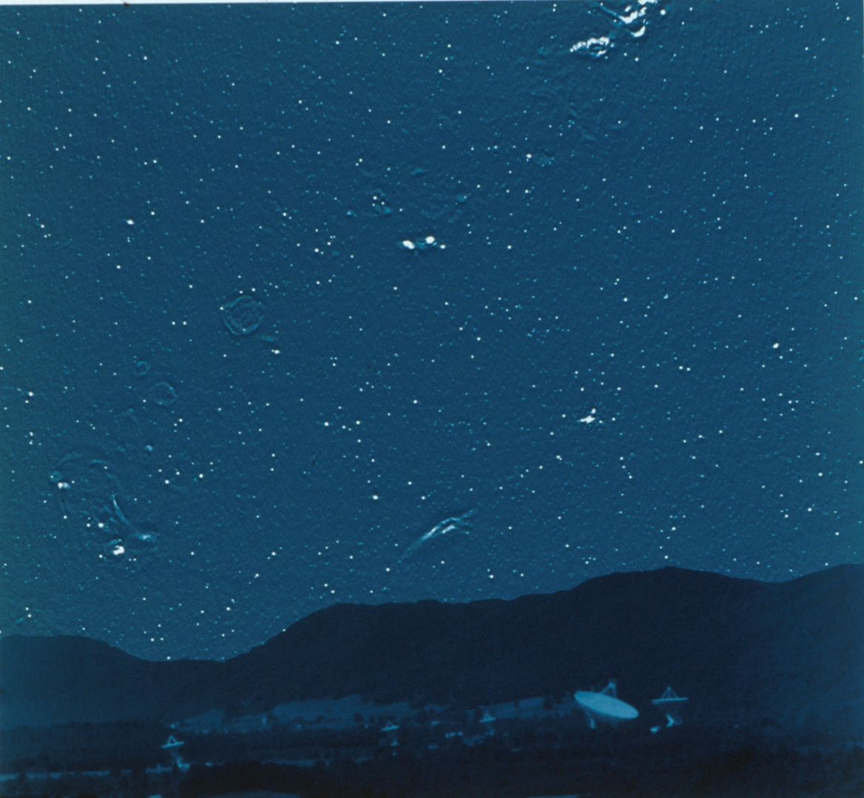
There are no stars
shown here!
Notes:
So what do we have here? No stars! Faint circles are Supernova remnants, The elongated blob near the mountains is a nebula. The rest? The small bright objects? They are all radio galaxies and quasars – objects that can be 1,5 or even 10 billion light years away! ( or ago!)
Radio waves from space carry information about some of the most intriguing natural phenomena yet discovered by human beings. This is the bailiwick of radio astronomy. However, the cosmic radio whispers reaching the earth compete with the electrical din produced by TV, radio, FM, radar, satellite and cell phone signals. Thus, the faint radio sign from space that memorialize the death of stars, or tell of awesome explosions triggered by black holes in galaxies well beyond sight, are nearly lost against the background of human-made static. Yet such radio waves contain the secrets of interstellar gas clouds and carry messages from the remnants of the Big Bang that propelled our universe into existence.

Slide 3
Radio Astronomy
Some ways to get kids involved with radio waves
Pulsars
Radio Jove
Inspire

Slide 4
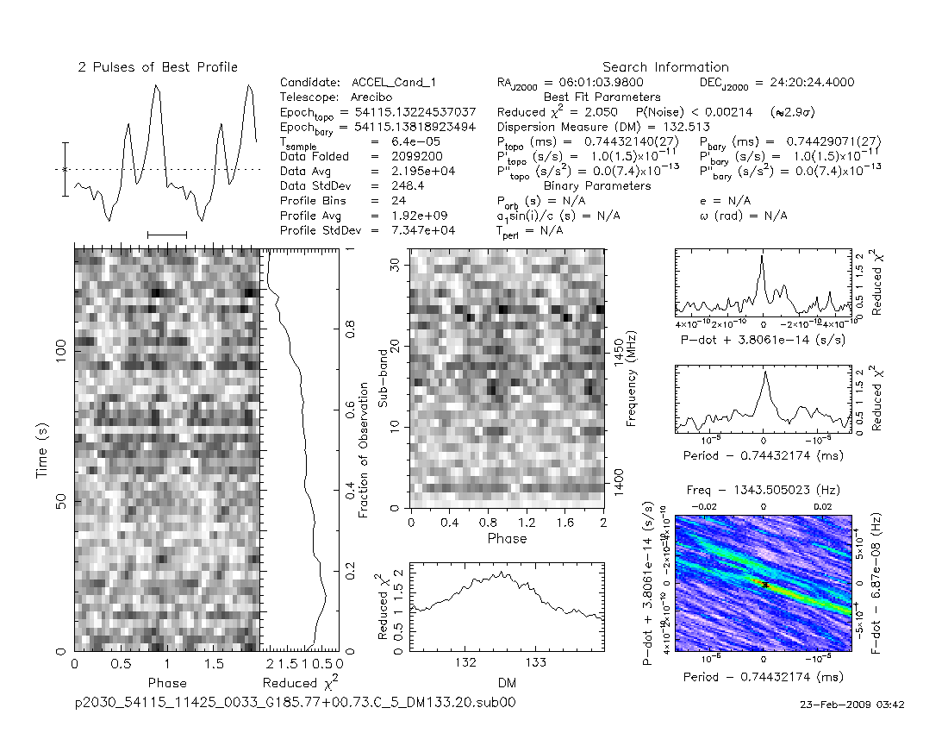
Pulsar Data

Slide 5
