Slide 1
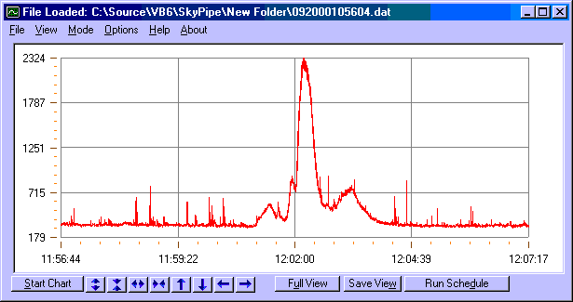
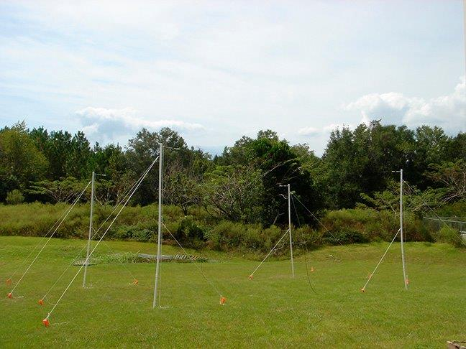
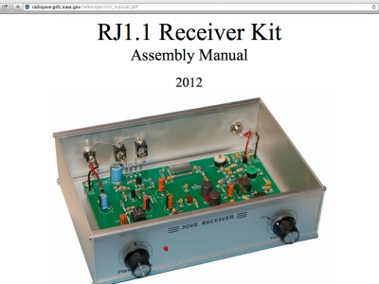
Radio Jove

Slide 2
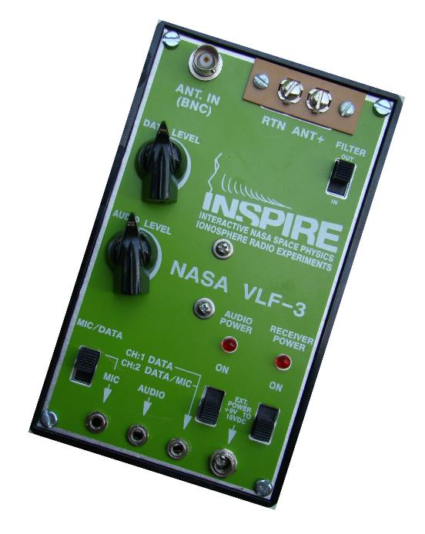
The Inspire project . . .

Slide 3
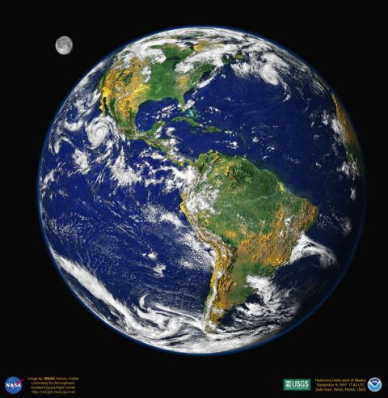
Natural radio frequencies produced by thunderstorms . . .

Slide 4
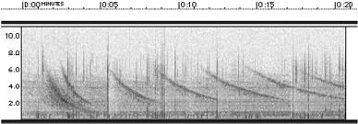
Whistler Echo Train
(Sound) Whistler Echo Train2: Credit – The INSPIRE Project
Notes:
Whistler Echo Train
Echo trains result when the radio wave bounces back and forth between magnetic conjugate points. Each time the signal bounces off the ionosphere, some of the energy leaks down in the lower atmosphere and is heard as a whistler.
Whistler Echo Train
Echo trains result when the radio wave bounces back and forth between magnetic conjugate points. Each time the signal bounces off the ionosphere, some of the energy leaks down in the lower atmosphere and is heard as a whistler.
All of the whistlers in the train are the result of a single lightning stroke. Successive "hops" of the whistler are seen with increasing dispersion time as the distance travelled grows with each bounce.

