Slide 1
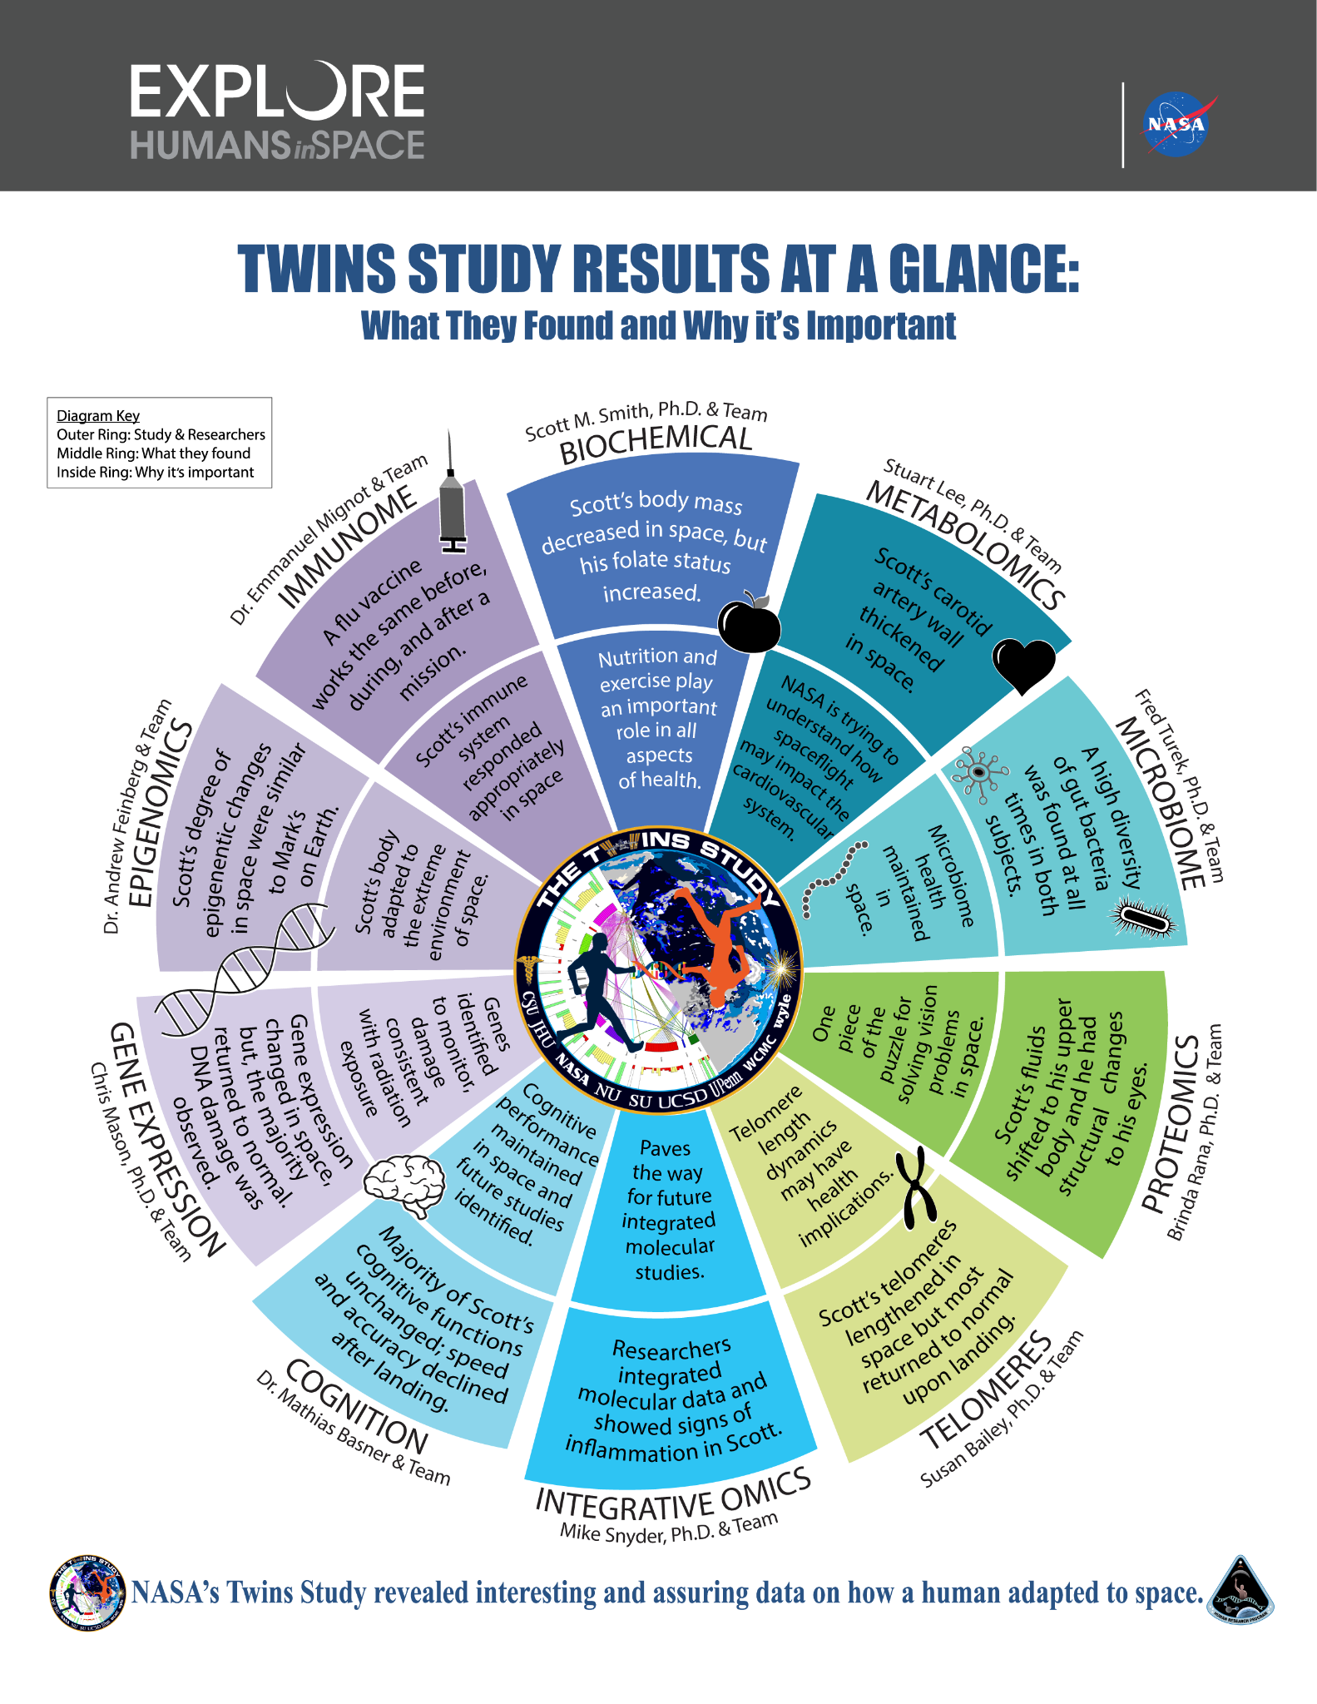
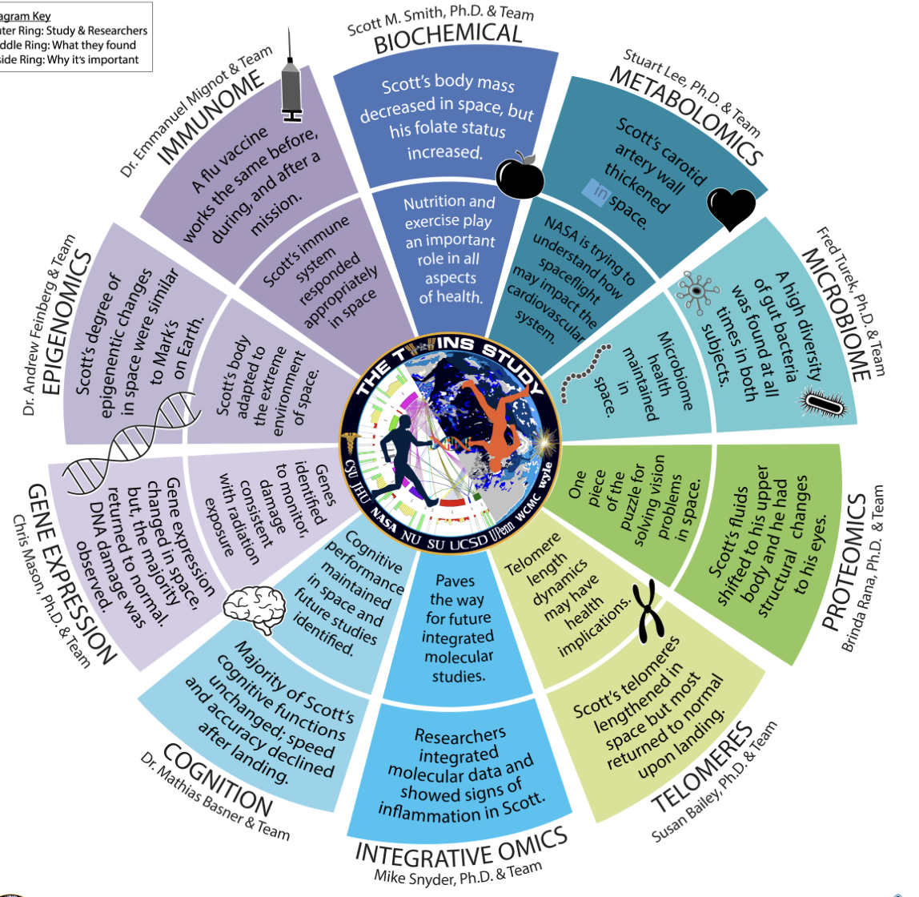
LIKE A JIG-SAW PUZZLE
NASA Twin Study
Name___________________________
Directions: Talk to your classmates about which ‘Omics’ video they watched. Have them explain the ‘gist’ then write their name in the box NEXT TO the ‘Omics’ video they watched.
Introduction
Everyone!
Using ‘Integrated Omics’ scientists from different fields worked together to understand how the human body adapts to microgravity in space.
Which piece (if any) is the most valuable? Why?
________________________________________________________________________________
“Basically, you could think of omics as a giant molecular jigsaw puzzle and once you put all the pieces together then you see a larger, more comprehensive picture of the human body at a fundamental, highly granular level”
4
4
1
Notes:
https://www.nasa.gov/content/exploring-space-through-you-omics

Slide 2
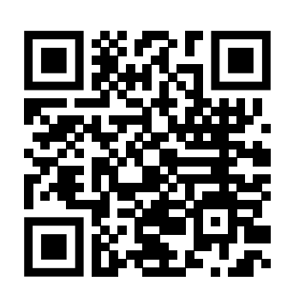
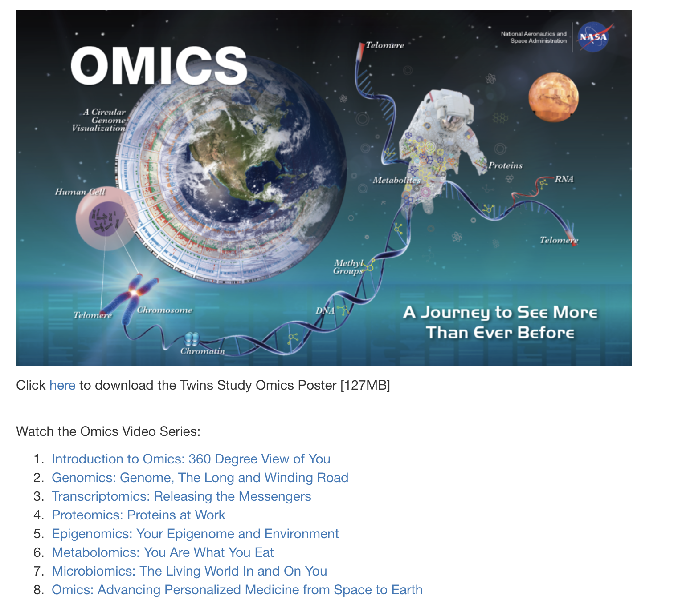
Watch
https://www.youtube.com/watch?v=m7X6mugpijQ
Analyze
https://www.nasa.gov/twins-study/omics-comes-alive
Directions: Scan the QR code, watch the video and then answer the questions below:
Directions: Answer the questions below after watching 1 of the ‘Omics’ videos on the NASA website.
Which video did you watch?
_________________________________________________
What was the MOST IMPORTANT message of the video?
_________________________________________________
_________________________________________________
What did you NOT like about the video?
_________________________________________________
What DID you like about the video?
_________________________________________________
What is the main purpose of the Twin Study? __________________________________________________How will these experiments make health care better?
___________________________________________________________________________
Watch some more:
Pair-up
Directions: TALK to your partner and then answer the questions:
Who between the 2 of you has a more interesting ‘Omics’ video?
___________________________________________________
WHY did you think this video was MORE interesting?
___________________________________________________
How does knowing this information make you a better human?
___________________________________________________
Directions:
Scan the QR code then choose a video from the website above and circle it here. Then answer the questions on the next page.
2
3
Notes:
https://www.nasa.gov/twins-study/omics-comes-alive
https://www.youtube.com/watch?v=m7X6mugpijQ

Slide 3
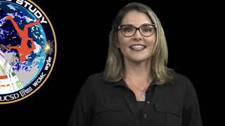
Teacher Resources
This lesson is an overview of all experiments scientists completed on Scott and Mark Kelly. Both are astronauts, Scott lived on the ISS (International Space Station) for 360 days while his identical twin Mark stayed on Earth. The experiments and tests scientists completed helped NASA learn how space travel might change people's bodies, and it also showed that our bodies are pretty amazing at adapting to new situations.
3 Key Findings

