Slide 1
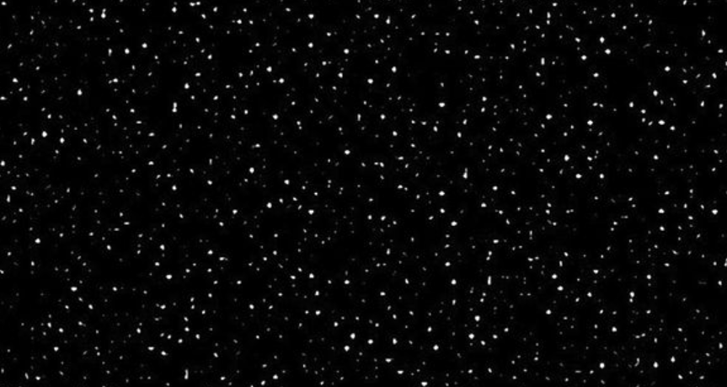
2-D Model of Earth to
2017 Voyager Locations
NGSS:
PS2A : Forces and Motion
ESS1-2 : Earth’s Place in the Universe

Slide 2
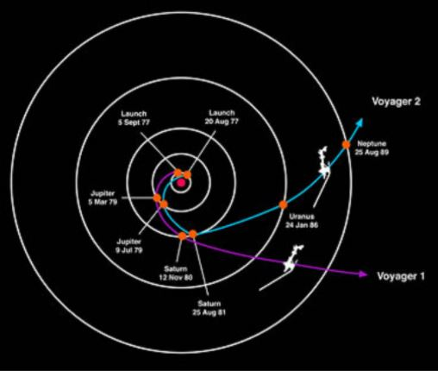

Slide 3
Sun | 1.0
Earth | 0
Mars | 0.52
Jupiter | 4.2
Saturn | 8.58
Distances in AU
1 AU = 93,000,000 miles
Uranus | 19.1
Neptune | 29.1
Termination Point:
Voyager 1 | 94
Voyager 2 | 84

Slide 4
Heliopause | 123 AU
Current | 141 AU
https://voyager.jpl.nasa.gov/mission/status/

Slide 5
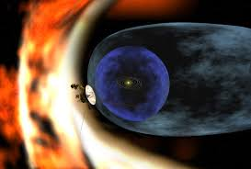
Notes:
The outward flow of charged particles making up the solar wind, along with the sun's magnetic field, define a gigantic region in space known as the heliosphere. It is shaped somewhat like a teardrop because of the sun's motion, due to the rotation of the Milky Way, combined with the effects of the sun's passage through a cloud of interstellar debris produced by ancient supernova. The tail of the teardrop stretches away in the opposite direction of travel.
The outward flow of the solar wind and the entwined magnetic field act as a shield of sorts for the inner solar system, affecting the passage of high-energy cosmic rays from deep space.

Slide 6
Slow wind turns, flows to drain
Notes:
Add heliosphere in the kitchen sink video

Slide 7
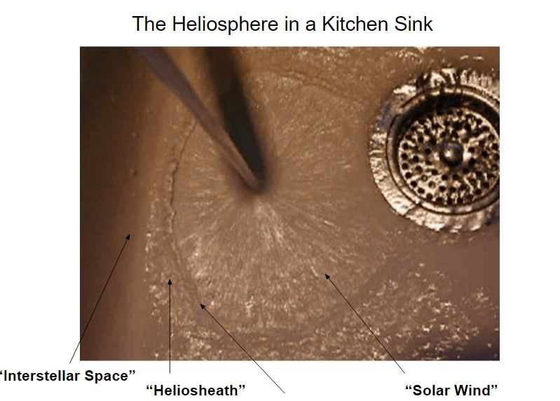
Slow wind turns, flows to drain
Notes:
Add heliosphere in the kitchen sink video

Slide 8
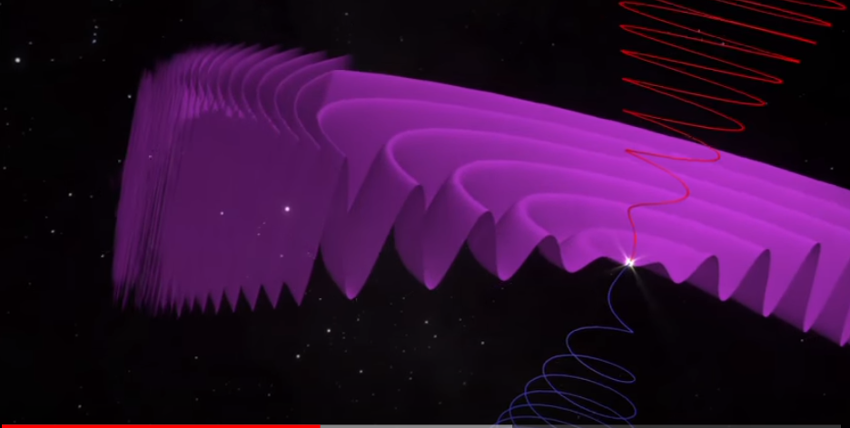
Slow wind turns, flows to drain
Notes:
The magnetic field from our star is forming in different directions as seen by the red and blue corkscrews from the spinning axis, pushing out toward the heliopause. As they hit the heliopause, the particles are pushed together and compressed causing some interesting things to happen.

Slide 9
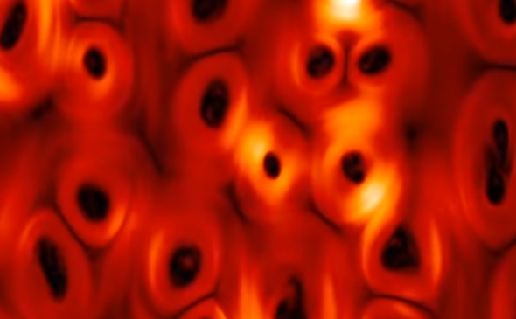
Notes:
Based on Voyager data, the boundary between the sun's influence and interstellar space may be marked by a region of magnetic turbulence defined by huge "bubbles" of disconnected magnetic energy. The bubbles are the result of the oppositely moving magnetic fields becoming cris-crossed and reconnecting sometimes violently and creating foaming magnetic bubbles and a high incidence of particles. The particles density varies and that is why scientists say there is the ‘bubble effect’ of these charged particles. Voyager 1 is reporting a variance of particle density as she sails into and between bubbles.

Slide 10
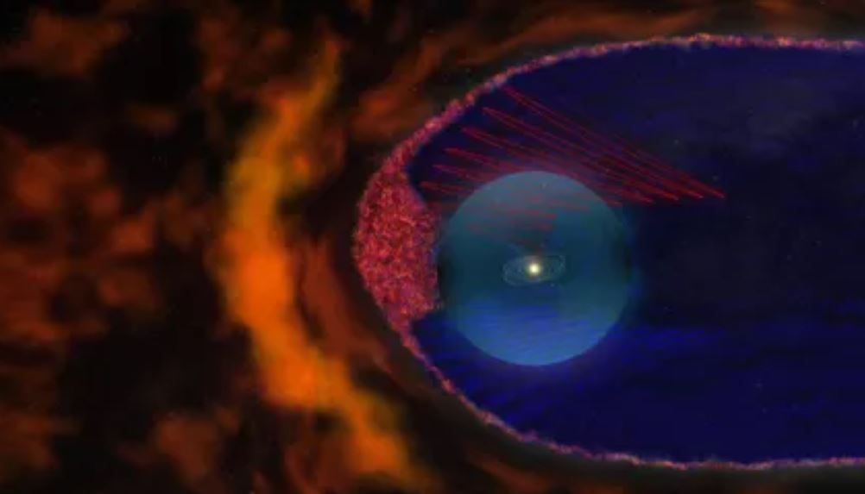
Notes:
Scientists believed the structure of the magnetic field at the interface between the heliosphere and interstellar space was relatively smooth. But based on data from the two Voyager spacecraft, it appears that huge 100 million mile long magnetic bubbles may form in the heliosheath in the sun's direction of travel. Add video here of foam bubbles

Slide 11
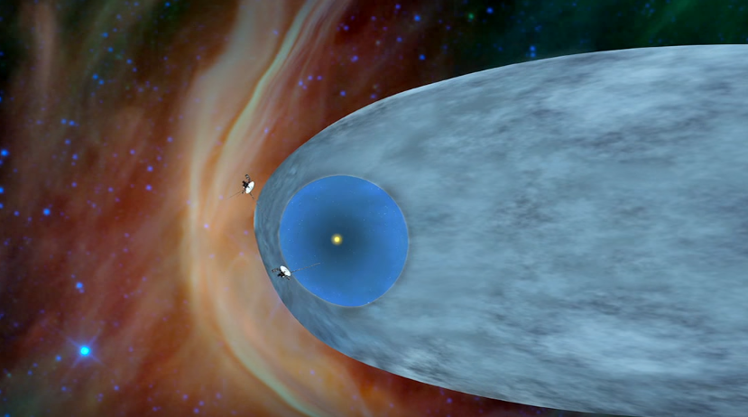
Notes:
Voyager 1 is now in interstellar space with Voyager 2 moving in a different direction, buy also approaching interstellar space.

Slide 12
2-D Model of Voyager Spacecraft Journey
Into the Heliopause….

