Slide 1
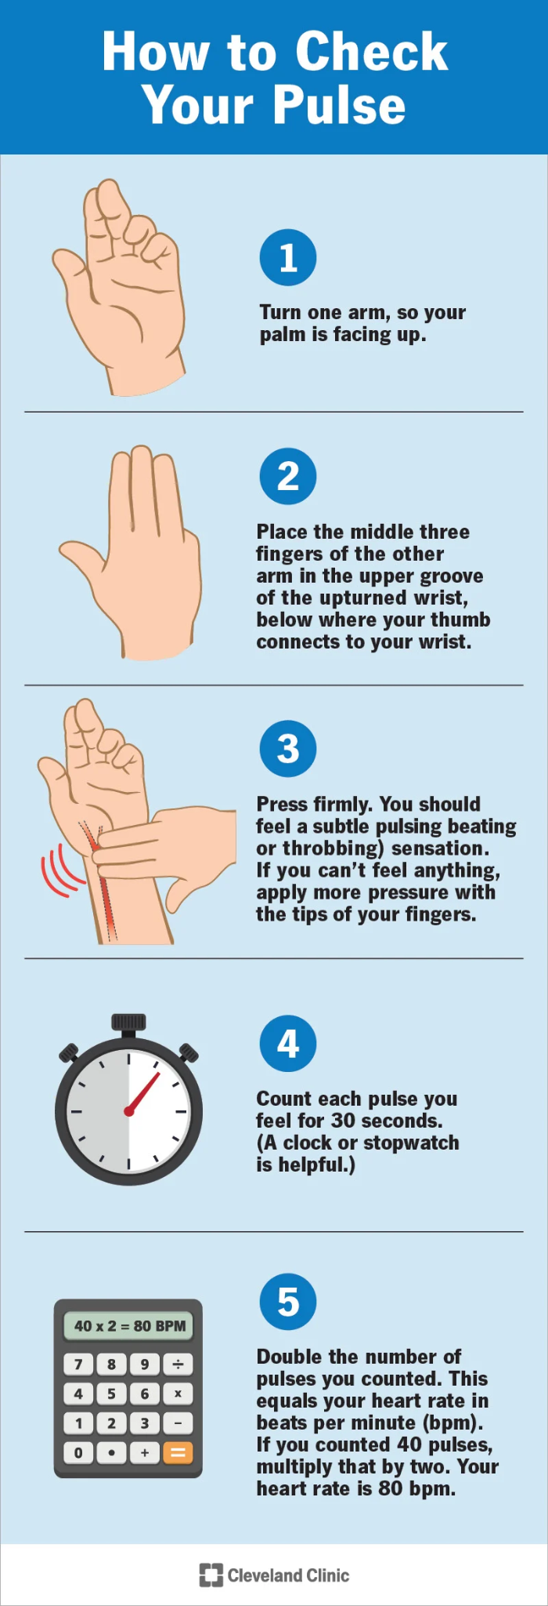
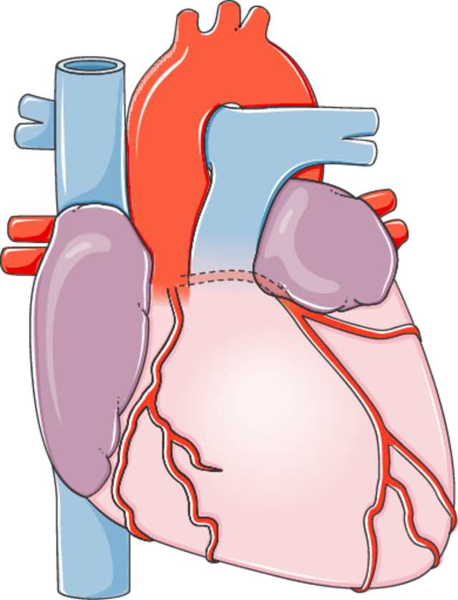
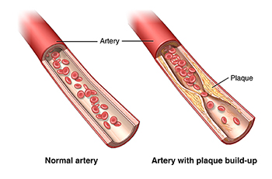
Name___________________________
Activity
Pulse
Check
Name___________________________
Metabolism
These experiments were designed to see how being in space can affect the insides of our blood vessels. They looked at a problem called atherosclerosis, which happens when the insides of our blood vessels get narrow because of stuff
https://www.youtube.com/watch?v=k8Sg311TNlg
building up on the walls. This can be caused by inflammation (when the body gets swollen and sore) and oxidative stress (when the body's parts get damaged). This study helps the scientists learn more about what happens to the heart and blood vessels during long trips in space.
Directions:
Watch the video.
Predict what your resting heart rate will be.
Practice taking someone’s pulse.
Take your partner’s resting pulse.
Do 1 minute of jogging in place.
Take your partner’s pulse.
Record the data below.
Results
They found signs that show inflammation and the walls of the blood vessel getting thicker in Scott while he was in space and right after he came back, but they didn't see the same things in Mark who stayed on earth. They're still not sure if the changes in Scott's body will go back to normal.
Heart rate in beats per minute (b/m)
 | Prediction | Resting | After 1 minute of jogging | 5 minutes later
me
partner
Inflammation leading to reduced blood flow.
How would inflammation of the blood vessels affect your pulse?
______________________________________________
4
4
4
1
Notes:
https://my.clevelandclinic.org/health/articles/23918-how-to-take-your-pulse
https://www.youtube.com/watch?v=k8Sg311TNlg

Slide 2
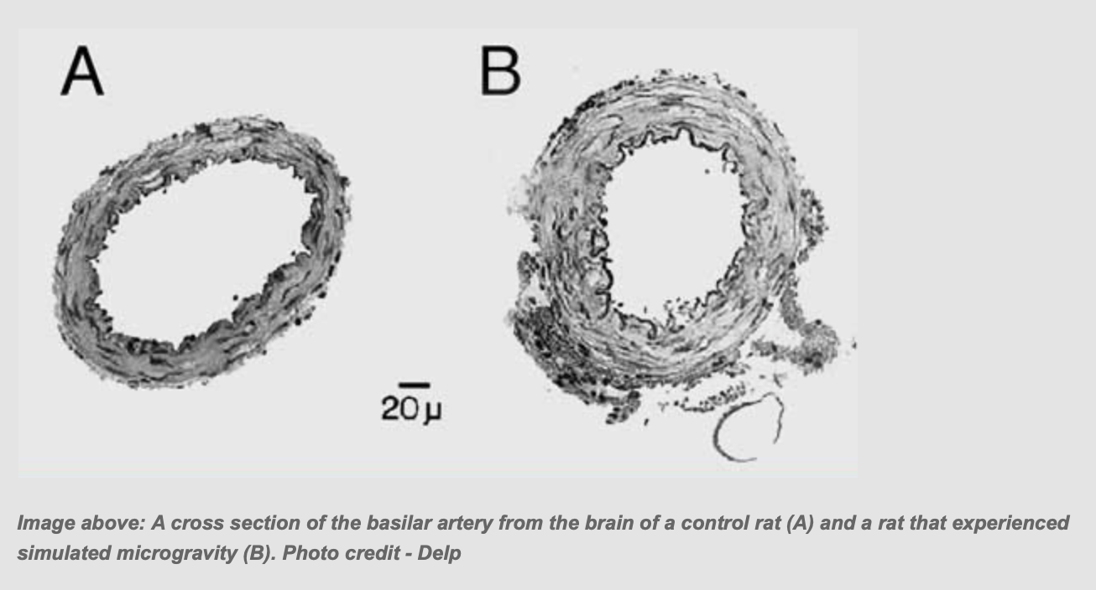
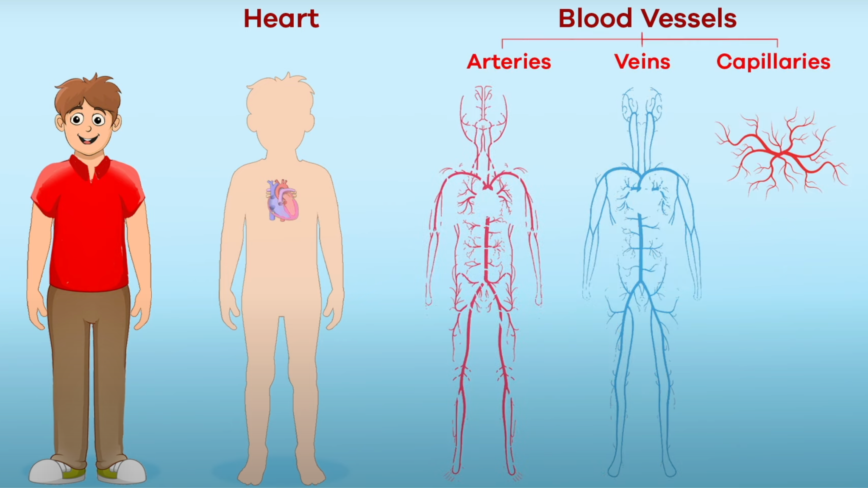
Read
Analyze
This study suggest that space can mess up how our immune system and inflammation responses work. We're not sure exactly why this happens. It might be because of stress or other things that happen during space travel. So far, there isn't solid proof that going to space directly makes this response more likely.
Normal Gravity
Microgravity
An inflammation responses in space can cause many different health problems, problems with arteries being one.
What factor in space could be the cause of inflammation in Scott’s arteries?
____________________________________________________________________________
Analysis:
Using the image above, compare and contrast the normal gravity blood vessels to the blood vessels in microgravity. Include ideas about the lumen size (opening), the thickness and stiffness of the artery walls.
Watch
Directions: Watch the video then fill in the types of blood vessels.
Microgravity
Normal Gravity
How do you think the reduced opening of the blood vessels in Microgravity will affect the astronauts blood flow to their brain? Is there any danger?
________________________________________________________________________________________________________________________
3
2
3
Notes:
https://www.nature.com/articles/s41526-020-0104-1#:~:text=Some%20astronauts%20experience%20allergy%2Dlike,underlying%20this%20dysregulation%20remain%20unclear.
https://www.nasa.gov/vision/earth/livingthings/arterial_remodel.html

