Slide 1
Electrostatics and Space
Frances Dellutri, USA
Deputy Education Manger
National Space Society

Slide 2
Our Future is the Settlement of Space . . .
The Spacedge Initiative is to Bring Robust Space Science Curriculum to 21st Century Learning through:
Critical Thinking
Lessons, Outreach Educational Materials
Web- Based Learning
Collaboration
Communication Skills
Real-world Hands-On Experience
Mentor Support

Slide 3
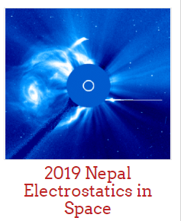
Please Go To:
spacedge.academy
All materials from today’s session are found on the SpacEdge Academy

Slide 4
Particles, Particles, Everywhere!
Notes:
In the physical sciences, a particle is a small localized object described by several physical or chemical properties such as volume, density or mass. A charged particle is a particle with an electric charge. It may be an ion, such as a molecule or atom with a surplus or deficit of electrons relative to protons. It can also be an electron or a proton, or another elementary particle, which are all believed to have the same charge^{[1]} (except antimatter). Another charged particle may be an atomic nucleus devoid of electrons, such as an alpha particle.
A plasma is a collection of charged particles, atomic nuclei and separated electrons, but can also be a gas containing a significant proportion of charged particles.

Slide 5
Here’s the vocabulary we’ll be using today:
Particle Radiation Magnetosphere
Coronal Mass Ejecta (CME) Ionosphere
Solar Wind Bow Shock
Muons Solar Particle Event (SPE)
Galactic Cosmic Ray (GCR) Photon
Interplanetary Magnetic Field (IMF) Aurora
Ionization Ion Plasma
Notes:
Let’s watch for these terms for clarification. You will see them mentioned or suggested several times throughout the session.

Slide 6
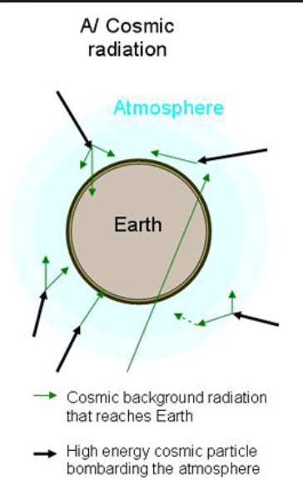
Let’s talk Particle Radiation-
Notes:
Particle radiation can be emitted by an unstable atomic nucleus (via radioactive decay), or it can be the product from some other kind of nuclear reaction. Many types of particles may be emitted: protons and other hydrogen nuclei stripped of their electrons. positively charged alpha particles (α)
Particle radiation is the radiation of energy by means of fast-moving subatomic particles. Particle radiation is referred to as a particle beam if the particles are all moving in the same direction, similar to a light beam.
Due to the wave–particle duality, all moving particles also have wave character. Higher energy particles more easily exhibit particle characteristics, while lower energy particles more easily exhibit wave characteristics.
Wave–particle duality is the concept in quantum mechanics that every particle or quantum entity may be partly described in terms not only of particles, but also of waves. It expresses the inability of the classical concepts "particle" or "wave" to fully describe the behaviour of quantum-scale objects.
Scientists have been able to isolate energized sub-atomic particles.

Slide 7
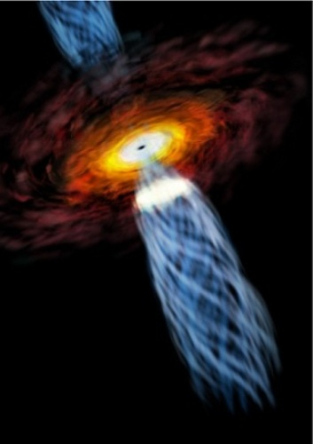
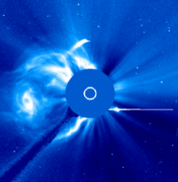
How do these tiny particles become energized?
Notes:
Coronal Mass Ejecta or CME happen when material works itself from inside our sun to the surface through fusion at the center of the sun and finally explodes from the sun carrying the material in a solar wind. Sometimes Earth is in the path of the CME. But there are other sources, too.
The center of our galaxy is home to many objects capable of producing cosmic rays of high energy, including, in particular, a supernova remnant, a pulsar wind nebula, and a compact cluster of massive stars.
The supermassive black hole located at the center of our Milky Way galaxy, called Sagittarius A Sgr A (‘Saj A’), spews out energized particles. Sgr A is found at the border of the constellations Sagittarius and Scorpius. These particles are not enough to account for the total amount of galactic particles we see, “ if, however, our central black hole was more active in the past,” the scientists argue, “then it could indeed be responsible for the bulk of the galactic cosmic rays or GCRs that are observed today at the Earth.”

Slide 8
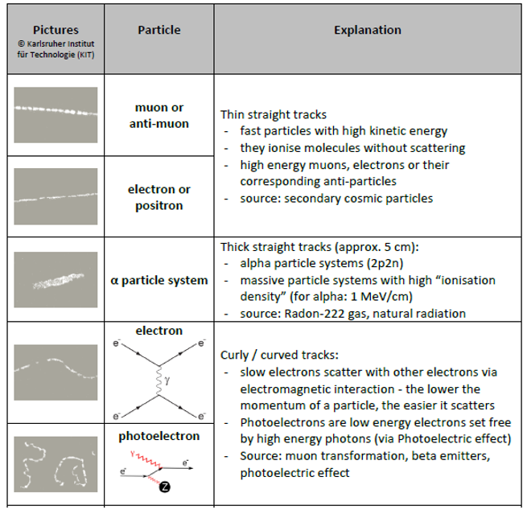
Notes:
These are the particle tracks that have been detected here on earth.

Slide 9
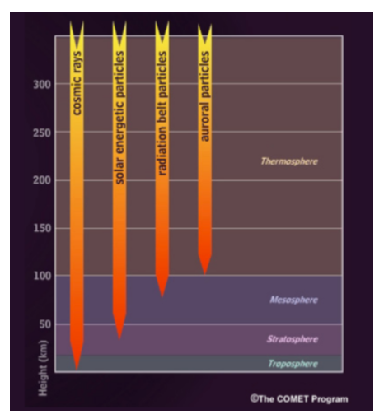
How far into our atmosphere do these particles penetrate?
---- Ionosphere ---------------→
Spacecraft, the aurora
Aircraft, clouds, mountains
Notes:
The ionosphere is an area that is ionized by solar radiation and extends from the earth to the edge of the magnetosphere which envelope Earth. The ozone layer in the stratosphere protects us from much of the solar radiation. Notice that the GCR’s or Galactic Cosmic Rays move all the way into the troposphere which is where we live.

Slide 10
Let’s take a look at the ionized particles that make it to Earth….

Slide 11
Instructions to make a Cloud Chamber to witness tracks made by charged particles from Galactic Cosmic Rays:
https://www.youtube.com/watch?v=400xfGmSlqQ

Slide 12
Q: How do you think your students would respond to a demonstration of a cloud chamber, watching the trails the GCR particles make as they ionize the alcohol in the cloud chamber?

