Slide 1
Radio – a little more . . .

Slide 2
NASA’s tour of the EM spectrum videos
Good videos!
Radio
https://www.youtube.com/watch?v=OzDmEA8x0nQ

Slide 3
How did we come to “see” radio waves?
When and where did this journey start?
In 1886 in Germany . . .

Slide 4
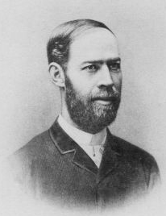
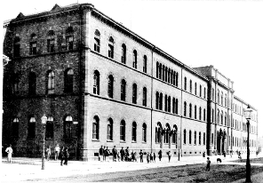
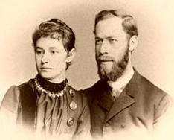
1886
The lecture hall in Karlsruhe
Heinrich Hertz
Elisabeth and Heinrich
Notes:
A little history first: In 1886, at the age of 29, Heinrich Hertz accidently constructed the first radio transmitter and receiver. In a darkened lecture theater in Karlsruhe, Germany, Hertz had set up an experiment to test what happened when an electrical current flowed in an open circuit (a circuit with a gap in it). As he explained the setup to his wife, Elisabeth, he switched on a spark generator, used to produce the current, and one of them noticed a simultaneous spark that flashed in an unrelated piece of equipment at some distance away from his main experimental apparatus. Whoever noticed it first, Heinrich or Elisabeth, is unknown, but it was Heinrich who made the leap of curiosities that underscore the nature of scientific research. Hertz asked “Why?” and started a systematic search for an answer.
He was not the first to see the odd effect, but he was the first to follow up on his key question. He showed these “electric” waves carried energy through space. He demonstrated these waves were very similar to light, and that their speed was the same. The waves were called Hertzian waves, which came to be called radio waves. Frequency is measured in cycles per second, now called Hertz (Hz). He died tragically at the young age of 35 of blood poisoning from an infected tooth.

Slide 5
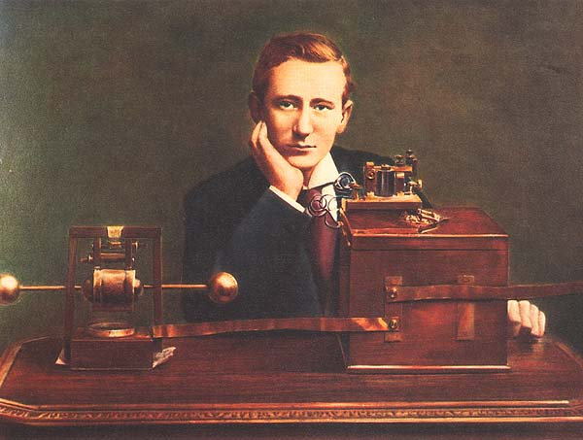
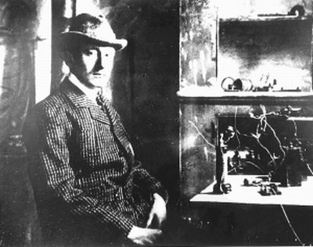
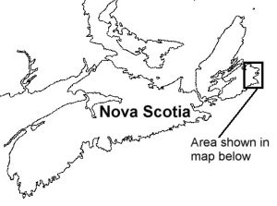
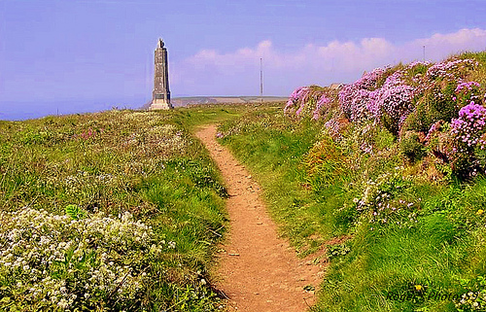
1st Trans-Atlantic Radio
Transmission 12/12/1901
Guglielmo Marconi
Notes:
Hertz wanted to know the nature of these waves, but he did not ask how far they might travel. This was left to Guglielmo Marconi, an Italian physicist who performed a series of creative experiments to prove that radio waves could travel enormous distance and even pass through rock. (He was wrong about the latter belief!). He did show that a radio signal could traverse the Atlantic Ocean Born (.[b. Bologna, Italy, April 25, 1874, d. Rome, July 20, 1937]
In 1894 Marconi read that Heinrich Hertz, by inducing an electric spark to jump across a gap, had produced invisible waves that travel through space. Marconi realized that the waves might be used to send wireless messages similar to the dot-and-dash messages sent by telegraphs. He began experimenting and within a year was sending messages over distances of more than a mile (1.6 km). Widespread use of radio was assured on December 12, 1901, when assistants in England sent the first transatlantic signals to Marconi in Newfoundland, a distance of some 4800 km (3,000 miles (some dispute this)
On 17 December 1902, a transmission from the Marconi station in Glace Bay, Nova Scotia, Canada, became the first radio message to cross the Atlantic from North America. On 18 January 1903, a Marconi station built near South Wellfleet, Massachusetts in 1901 sent a message of greetings from Theodore Roosevelt, the President of the United States, to King Edward VII of the United Kingdom, marking the first transatlantic radio transmission originating in the United States. However, consistent transatlantic signalling was difficult to establish.)

Slide 6
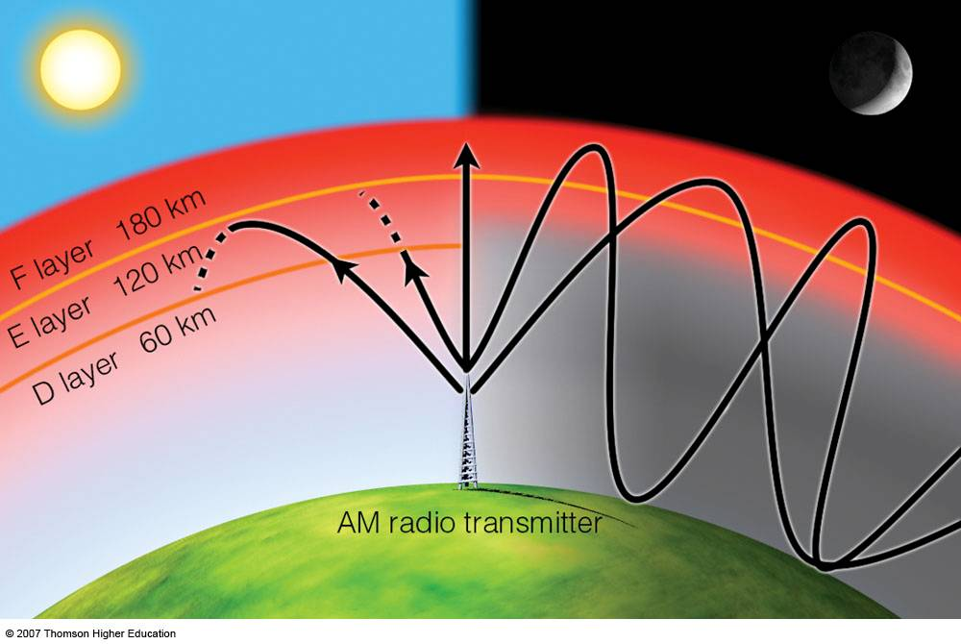
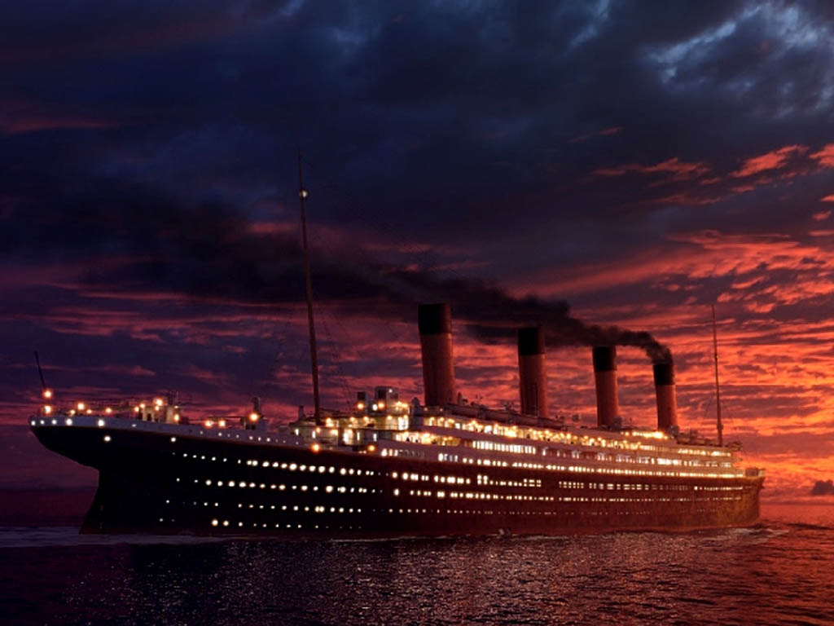
Notes:
The reason the radio waves made it across despite the curvature of the earth was because the earth’s atmosphere is surrounded by an electrically conductive layer known as the iionosphere and radio waves bounce off that layer to be reflected across the ocean. That would not be understood until decades later. Marconi was happy to know radio waves went all the way around the earth, and it was not long before ships at sea could signal one another and their home parts using radio waves. By 1912, the infamous sinking of the Titanic spread awareness that radio transmitters could send an SOS far and wide.
(The Ionosphere and Radio Wave Propagation
The ionosphere is important for radio wave (AM only) propagation....
ionosphere is composed of the D, E, and F layers
the D layer is good at absorbing AM radio waves
D layer dissapears at night.... the E and F layers bounce the waves back to the earth
this explains why radio stations adjust their power output at sunset and sunrise)

Slide 7
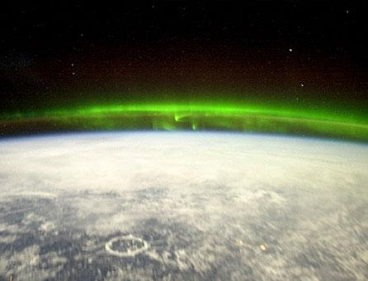
Notes:
Marconi did wonder whether there might be radio waves reaching earth from space but his equipment would not reveal the existence of the invisible universe for the same reason that he could signal across the Atlantic. At the low radio frequencies that Marconi used, the reflecting ionosphere not only allows radio signals to bounce around the curvature of the earth, it also prevents radio waves from space from reaching the earth’s surface. Those that do arrive from space are reflected back. Only if their intrinsic frequency is higher than 10-20 MHz do such radio waves reach the ground, but very little was known about building receivers at such frequencies!

Slide 8
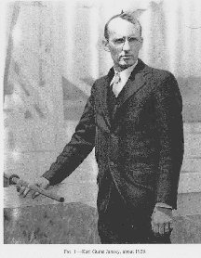
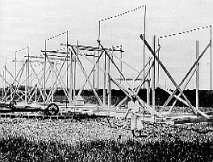
Karl Jansky
Jansky’s antenna
Notes:
This brings us to the late 1920’s and Karl Jansky, an employee at Bell laboratories. In 1927, one could speak for three minutes between New York and London for $75. But the links were terribly susceptible to electrical interference. The first system operated at 60 KHz, a wavelength of 5 km. In 1929, a change was made to short waves whose frequencies were in the range of 10-20 MHz. But the new telephone links were still susceptible to electrical disturbances of unknown nature, which plagued connections. Jansky was assigned the task of locating the interference. To carry out his studies, he built a rotating antenna, operating at 20.5 MHz. BY 1930 he was taking regular observations. By 1932, he could report that local and distant thunderstorms were two sources of radio noise, and a third source was “a very steady hiss-type static, the origin of which is not yet known.”
By 1933, he was unambiguously able to demonstrate that the source of the signals was outside the earth, and presented a report entitled “electrical disturbances apparently of extraterrestrial origin.” And so radio astronomy was born.

