Slide 1
Name___________________________
Name___________________________
Directions: Read this article and answer the questions below:
https://www.cnn.com/2018/03/14/health/scott-kelly-dna-nasa-twins-study/index.html
A process that uses DNA to create proteins. These proteins are responsible for our traits
Gene Expression
What does it mean that Scott’s gene expression changed?
________________________________________________________________________________________________________________________________________________
Did Scott look different due to these changes? Why or why not?
____________________________________________________________________________________________________________
What does it mean that some of Scott’s gene expression did not change back after spaceflight? ____________________________________________________________________________________________________________
What does this tell us about what space does to our genes?
________________________________________________________________________
NASA scientists study gene expression to see if the body makes different proteins in microgravity
Results
Scientists examined Scott’s genome in space and compared it to Mark’s genome on Earth. They discovered that 91.3% of Scott’s genome returned to normal after landing. BUT this leaves almost 9% of his genome still producing proteins different from the proteins he was producing before his year in space.
Predict: What kind of environmental factors in space could lead to this change in gene expression?
___________________________________________________________________________________
____________________________________
4
4
4
1
Notes:
https://commons.wikimedia.org/wiki/File:Exemplo_Mendel.jpg
https://publicdomainvectors.org/en/free-clipart/Man-in-DNA/71287.html

Slide 2
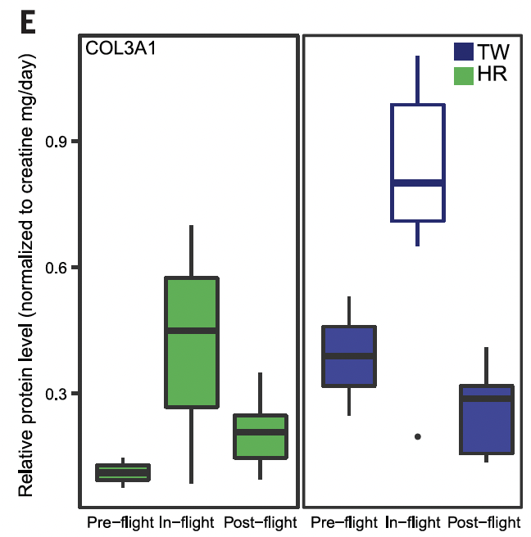
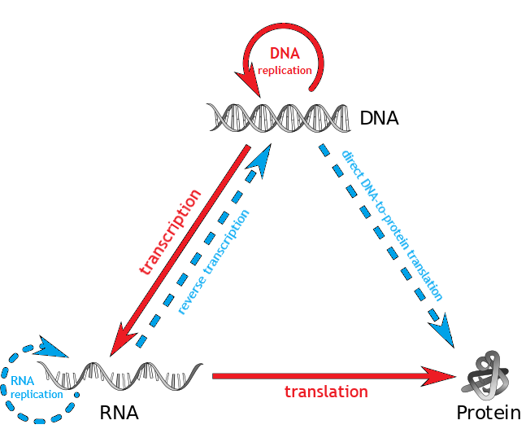
Read
Analyze
Genes are sections of DNA that are the code (or recipe) to make specific proteins in the body. Your DNA is transcribed into RNA, then this RNA is translated into proteins.
This graph shows levels of the protein collagen in each subject’s blood plasma. Collagen is the main component of connective tissues like blood, bones, and cartilage.
Gene expression refers to the amount of a protein that gets made at certain times. If gene expression changes, the amount of certain proteins in the body changes!
Watch
https://www.youtube.com/watch?v=FZHs-TZtWKQ
https://www.youtube.com/watch?v=xfwa1_1waIg
What is the Central Dogma of Biology?
_________________________________________________________________________________________________________
How did Scott’s (TW) collagen expression (production) change in flight? Did it return to ‘normal’?
________________________________________________________________________
____________________________________
How did Mark’s (HR) collagen expression (production) change while on Earth? Did it return to ‘normal’?
__________________________________________________________________________________________________________
Why might gene expression or the making of proteins change? ________________________
________________________________________________________________________
3
2
3
Notes:
https://www.youtube.com/watch?v=xfwa1_1waIg
https://www.youtube.com/watch?v=FZHs-TZtWKQ

