Slide 1
Aurora Colors

Slide 2
Green Aurora
Lowest auroras - 100 kilometers high
Involve atmospheric oxygen atoms excited by fast moving plasma from space
http://apod.nasa.gov/apod/

Slide 3
Red Aurora
Altitude - 200 kilometers high
Emitted by resettling atmospheric oxygen
http://southiceland.blogspot.com/

Slide 4
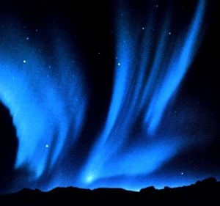
Blue Aurora
Highest auroras - 500 kilometers high
Caused by sunlight-scattering nitrogen ions
C
http://southiceland.blogspot.com/

Slide 5
All Colors Together
Astronomy Picture o the Day

Slide 6
All Together
http://southiceland.blogspot.com/

Slide 7
Aurora over Alps
Astronony Picture of the Day

Slide 8
Aurora With Fireball & Reflection
Aurora and Fireball over Norwa

Slide 9
Aurora Storm Directly Overhead

Slide 10
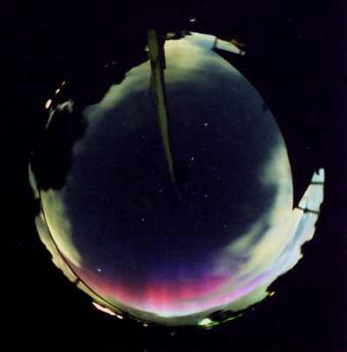
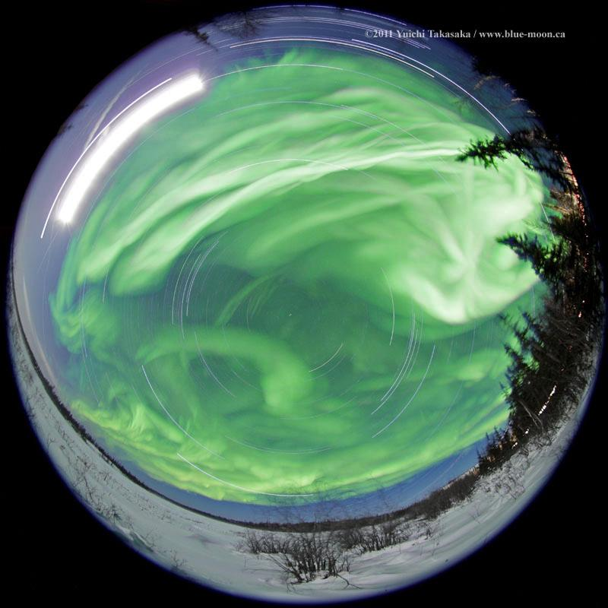
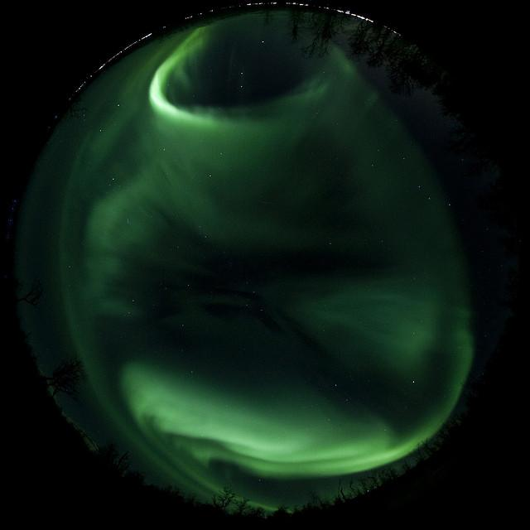
All Sky Camera Views

Slide 11
Aurora in Star Trails
Astronomy Picture of the Day

Slide 12
All Sky Camera South Pole

Slide 13
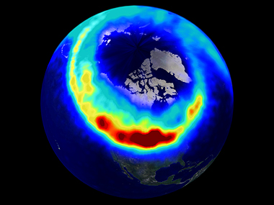
Aurora From Space

Slide 14
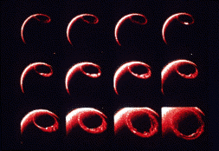
Solar Storms & CMEs Cause Oval To Expand and Contract

Slide 15
Aurora From Space
http://southiceland.blogspot.com/

Slide 16
Aurora Over Midwest From ISS
Astronomy Picture of the Day

Slide 17
Aurora From Shuttle Discovery
Astronomy Picture of the Day

Slide 18
Planetary Aurora

Slide 19
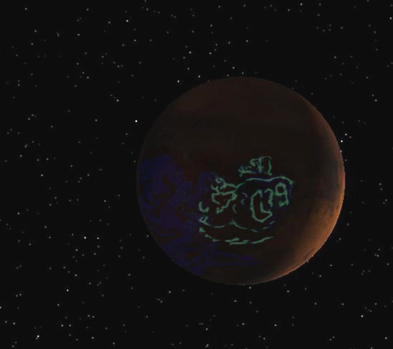
Planetary Aurora Mars – Artist’s Conception

Slide 20
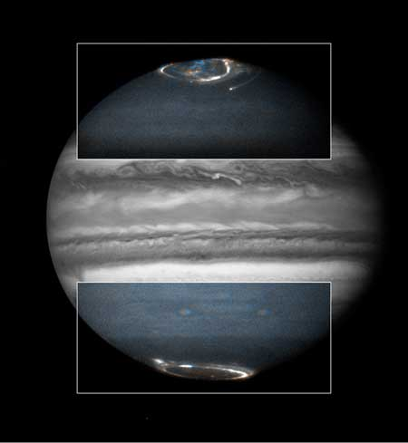
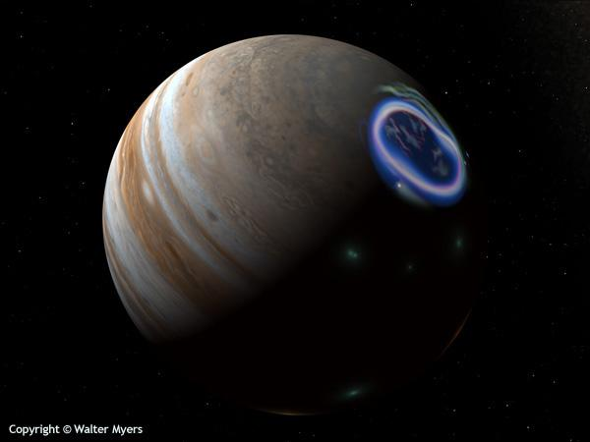
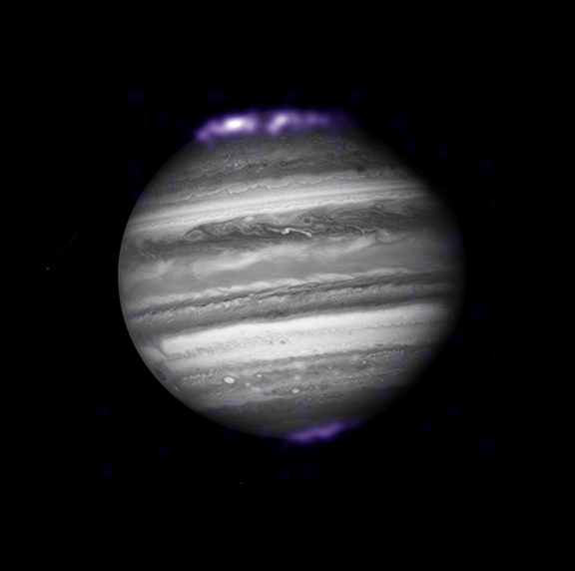
Planetary Aurora Jupiter

Slide 21
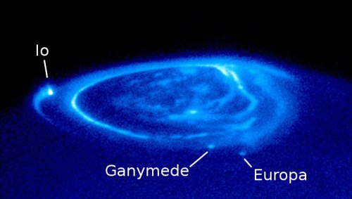
Planetary Aurora Jupiter and Io

Slide 22
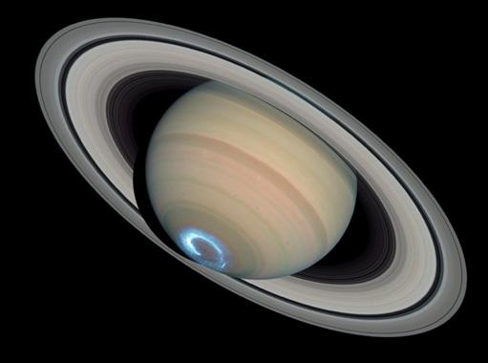
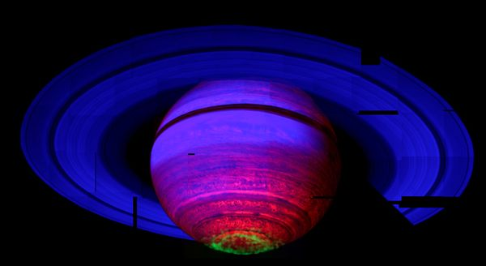
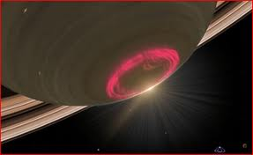
Planetary Aurora Saturn

Slide 23
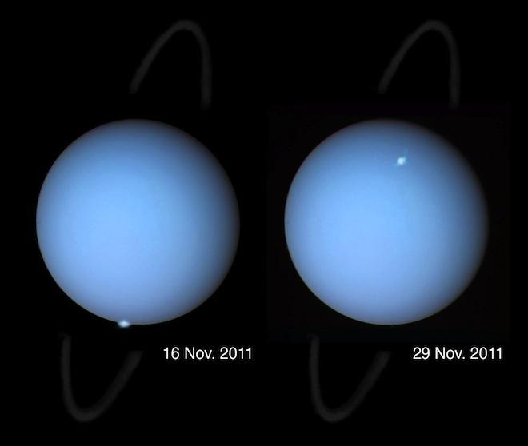
Planetary Aurora Uranus

Slide 24
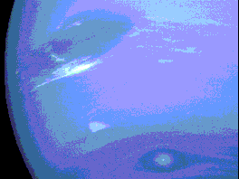
Planetary Aurora Neptune

Slide 25
Thanks
http://southiceland.blogspot.com/

