Slide 1
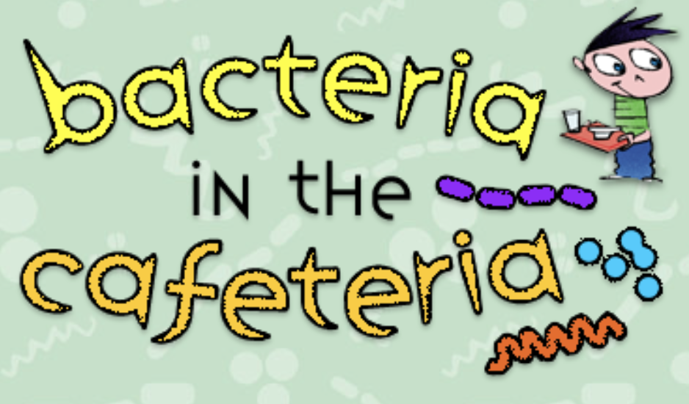
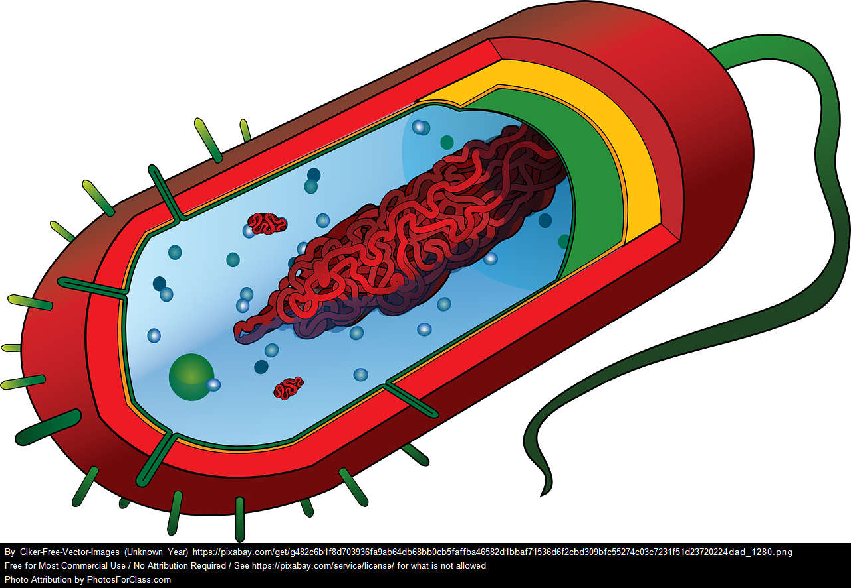
Name___________________________
Activity
Directions: Play the online search for microbes:
Name___________________________
Microbiome
The microbiome is a collection of microbes that live in or on the body.
https://www.amnh.org/explore/ology/microbiology/bacteria-in-the-cafeteria-game
NASA scientists study the human microbiome to better understand what these microbes do for us and if the ychange in microgravity
A microbe is a living thing that can only be seen with a microscope.
What was your score? ____/12
What is the answer to the riddle “Why don’t microbes get married?”
Because they are _ _ _ _ _ _ - _ _ _ _ _ _ !
What was something that surprised you about this exercise?
_______________________________________
_______________________________________
How do your gut bacteria help you?
________________________________________________________________________________
Results
Scientists studied the different types of bacteria in Scott’s gut (intestines) to find out more about the effects of spaceflight on the human microbiome. Scott’s microbiome changed while in spaceflight but returned back to normal once he returned to Earth.
Predict: How can you change your microbiome? _____________________________________________________________________
What types of foods could you eat that would introduce new/different microbes into your intestines?
____________________________________
4
4
4
1
Notes:
https://www.amnh.org/explore/ology/microbiology/bacteria-in-the-cafeteria-game

Slide 2
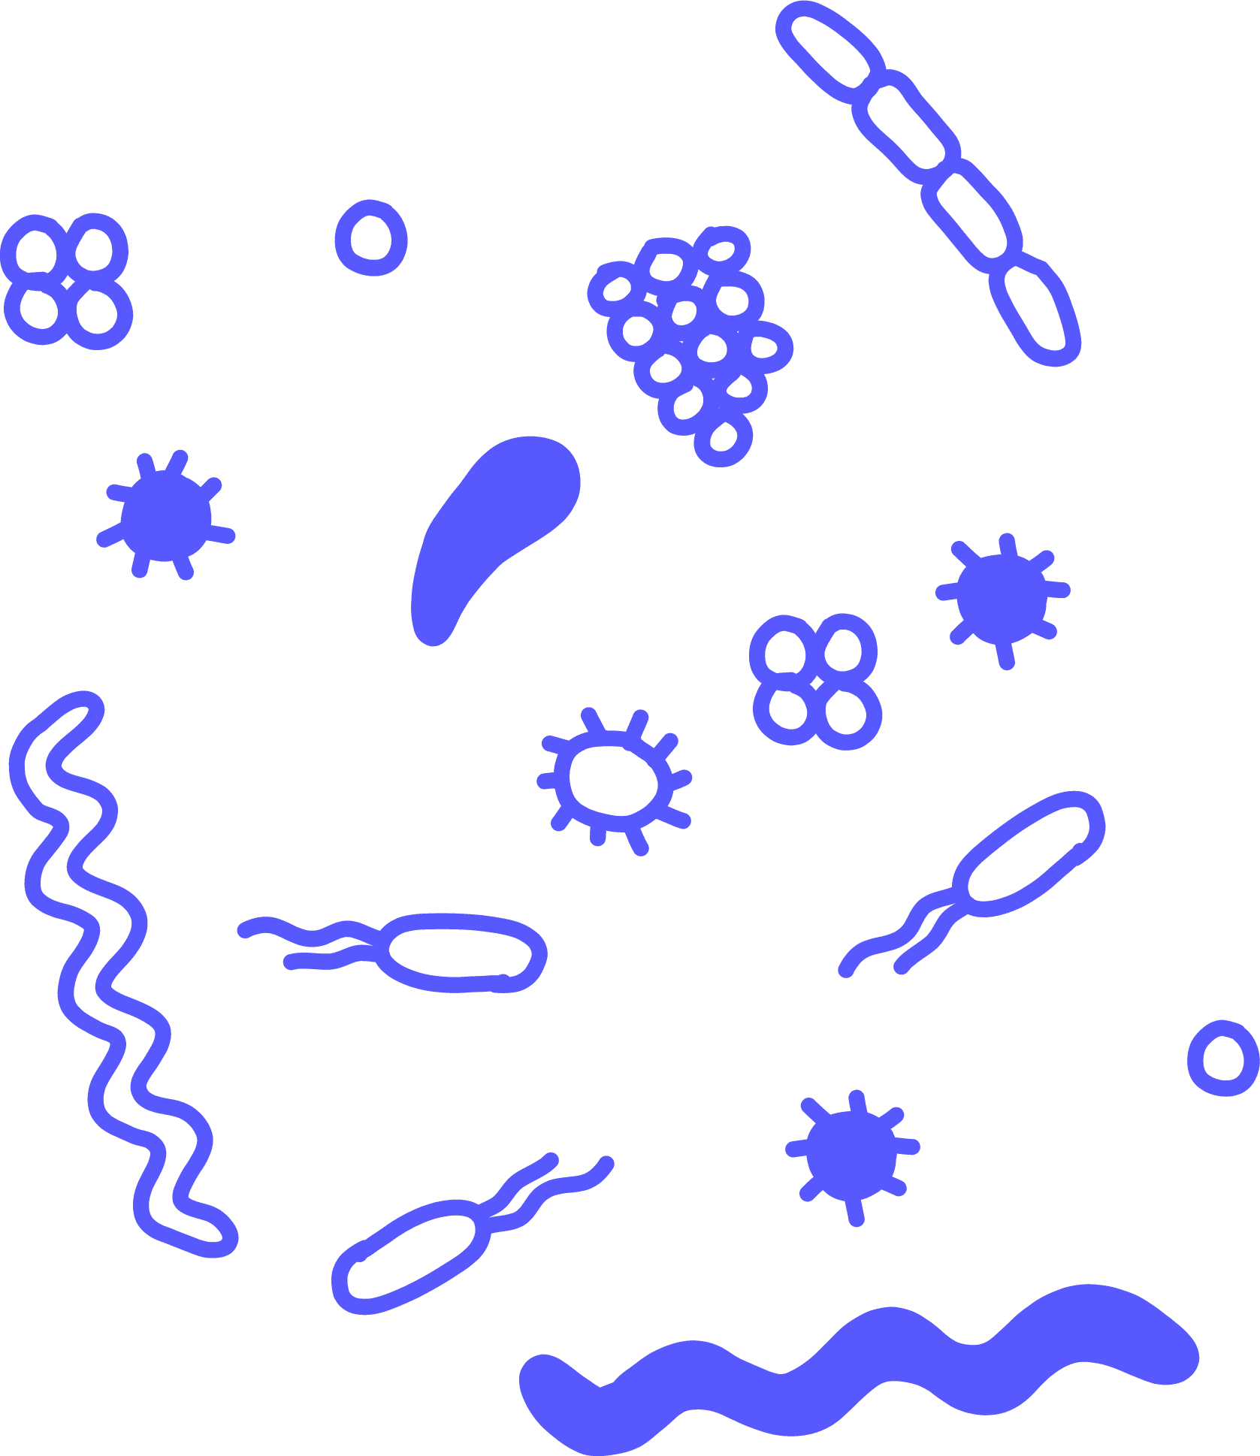
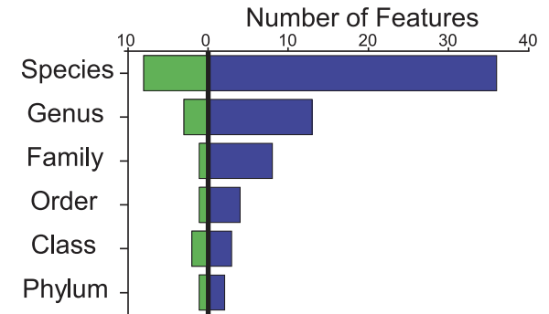
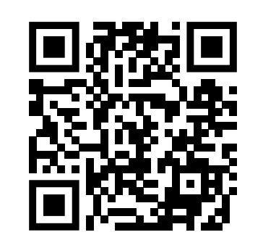
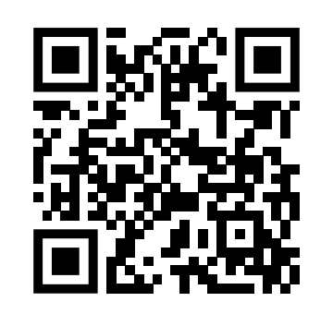
Read
Analyze
There are TRILLIONS of microscopic organisms called bacteria swimming around your digestive system!
Some are bad, causing infections or inflammation, but many are good!
The graph below…
They help us digest parts of food that we otherwise cannot. Your gut bacteria has a large impact on your health overall, and it can change drastically based on your diet and environment.
Watch
https://www.youtube.com/watch?v=5DTrENdWvvM
https://www.youtube.com/watch?v=IlejgR0DM-g
Our bodies are home to billions of microbes. Name all the places we can find microbes in or on our body.
______________________________
__________________________________________
How many more species of bacteria does Scott (TW) have in his gut than Mark (HR)?
________________________________________
Can you think of some reasons WHY Scott’s microbiome may have changed? And why might it have reverted back to ‘normal’ after the flight?
______________________________________________________________________________________________________________________________________________
What types of environmental factors can affect your microbiome?
____________________________
__________________________________________
3
3
2
3
Notes:
https://www.youtube.com/watch?v=5DTrENdWvvM
https://www.youtube.com/watch?v=IlejgR0DM-g

